Slide 1


Linux for Cloud
&
DevOps Engineers - Hands-on!!

Slide 2
Linux for Cloud & DevOps Engineers - Hands-on!!
About Instructor
IT Industry Experience – 14 Years
Passion – Online Job Oriented Certified Courses
Teaching Over to 40k Students
Shikhar Verma

Slide 3
Linux for Cloud & DevOps Engineers - Hands-on!!
Introduction
Linux Filesystem Structure & Basic commands
User Administration
User’s Home Directory In Linux
Managing Permissions in Linux
Troubleshooting Instance launch Issues
EC2 - Elastic Compute Cloud
Systemd - System and Service Manager
Bonus AWS Systems Manager

Slide 4
Docker training bootcamp
Course Content
Introduction
Introduction about containers
Installation of Docker
Create a first container
Fetch container image from docker hub
Run a container in backgroup, interactive with tty terminal
Delete exited dockers using a single command
Get complete details of a running container
Check logs & stats of a running container
Port forwarding

Slide 5
Docker training bootcamp
Course Content
Introduction
exec, rename & restart the running container
Attach a container
Kill/stop, pause/unpause a container
Create, start, cp command
Export/Import Command in Docker
Create a image from running container
Pull a specific version image from Docker hub
Image history, inspect & remove image

Slide 6
Docker training bootcamp
Dockerfile
Overview of Dockerfile, layered architecture
Create a centos 7 image using Dockerfile
Overview of LABEL, ENV & RUN Command
Overview of WORKDIR
Copy, add command with their differences
Create a user account with password using dockerfile
CMD Command
SSH to a container
Overview of EXPOSE Command
ENTRYPOINT in Dockerfile

Slide 7
Docker training bootcamp
Manage Data in Docker
Overview of managing data in Docker
Volumes
Create & attach a volume to a container
Delete volumes from the Docker host machine
Bind mounts

Slide 8
Docker training bootcamp
Networking in Docker
Bridge networking
Run containers in custom created bridge networking
Enable communication between dockers belong to different bridge network
DNS enabled with custom bridge networking
Host networking
None networking
Connect one or more network to a running container
Create private docker registry
How to allow image in private registry for non-secure network

Slide 9
Docker training bootcamp
Docker Compose
Overview of docker compose
Docker compose Installation
Create my first docker compose file
Create docker compose file in json language
Learn basic commands
docker-compose up
docker-compose down
docker-compose create
docker-compose start
docker-compose stop

Slide 10
Docker training bootcamp
Docker Compose
Learn basic commands
docker-compose rm
docker-compose images
docker-compose ps
docker-compose pause
docker-compose unpause
docker-compose kill
docker-compose port <servername> port
docker-compose logs
docker-compose exec

Slide 11
Docker training bootcamp
Docker Compose
Learn basic commands
docker-compose run
docker-compose scale
docker-compose top
Attach a volume & port mapping using docker compose
Build a custom image using docker compose
Last lecture

Slide 12


Slide 13

Docker training bootcamp

Slide 14


Slide 15

Docker training bootcamp

Slide 16


Slide 17
Linux System Administration
Prerequisites
PC or Laptop with internet Connection.
RHEL 7,8 or CentOS, VMware Workstation & Oracle VirtualBox.
Basic Knowledge of Linux Administration would be required as it is a intermediate level course module.

Slide 18
Linux System Administration
Audience
IT professionals who are in Linux admin job & wants to get hands-on practical experience on advance topics of Linux.

Slide 19
Linux System Administration
About Course Module
10-11 Hours of Video Contents
Theoretically Sessions covered with Practice Lab Sessions
30 days money back guarantee

Slide 20
Docker
Login to https://docs.docker.com/ and click on Download and install.
Docker Installation

Slide 21
Docker
Create a first container, run container, list container, stop & remove container.

Slide 22
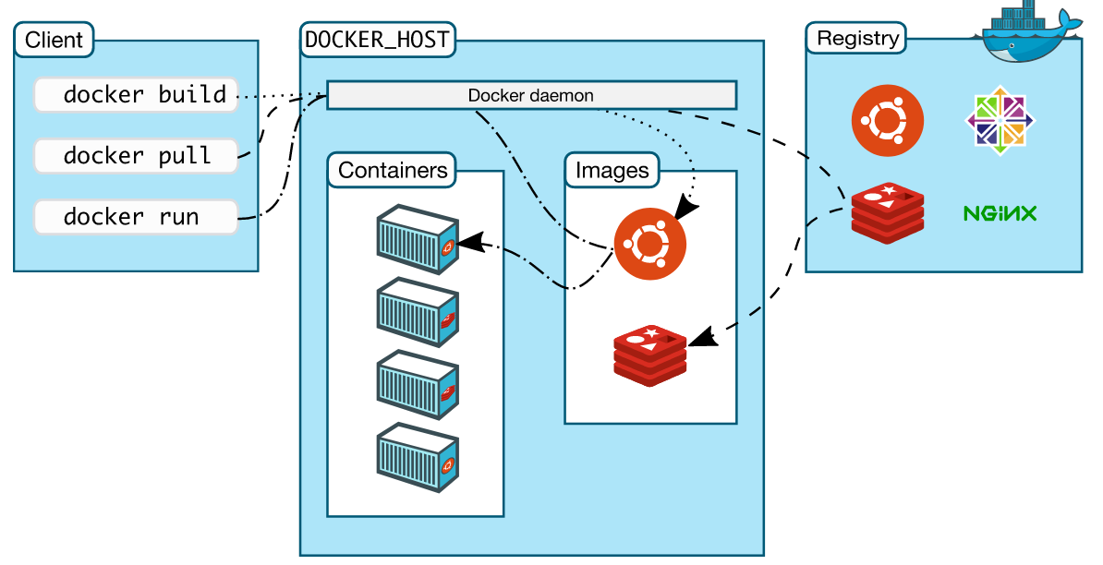

Slide 23
Docker
Create and run a container in background and also run it in interactive with pseudo terminal.

Slide 24
Docker
How to get the complete details of a running container?

Slide 25
Docker
How to get the logs & stats of a running container?

Slide 26
Docker
Port forwarding ➔ Run a container (nginx) on docker host with a port forwarding.

Slide 27
Docker
How to get inside the running container, how to rename & restart the container.

Slide 28
Docker
How to attach a container which is running in background?

Slide 29
Docker
How to kill/stop a running container, pause etc

Slide 30
Docker
Understand create, diff, start, cp command.

Slide 31
Docker
Export/Import command

Slide 32
Docker
Create a image from running container.

Slide 33
Docker
How to pull a specific version image?
How to push your image to docker hub?

Slide 34
Docker
How to pull a specific version image?
How to push your image to docker hub?

Slide 35
Docker
Overview of Image history command, remove & inspect image and how to format the command according to the requirement?
Reference link: https://docs.docker.com/engine/reference/commandline/images/#format-the-output

Slide 36
Docker
Dockerfile: A Dockerfile is a text document that contains all the commands a user could call on the command line to assemble an image.
Reference : https://docs.docker.com/engine/reference/builder/

Slide 37
Docker
Dockerfile: Overview of LABEL, ENV, RUN, WORKDIR

Slide 38
Docker
Dockerfile:
Copy, add command & its differences.
Create a user account with password.

Slide 39
Docker
Dockerfile:
CMD command.

Slide 40
Docker
Dockerfile:
SSH to a container

Slide 41
Docker
Dockerfile:
ENTRYPOINT instruction allows you to configure a container that will run as an executable. It looks similar to CMD, because it also allows you to specify a command with parameters.

Slide 42
Docker
Manage data in Docker

Slide 43
Docker
Create & attach a volume to a container

Slide 44
Docker
Bind mounts

Slide 45
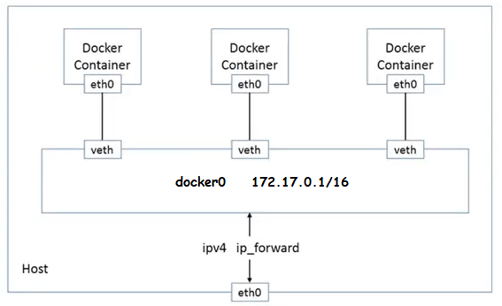
Docker
Bridge networking

Slide 46
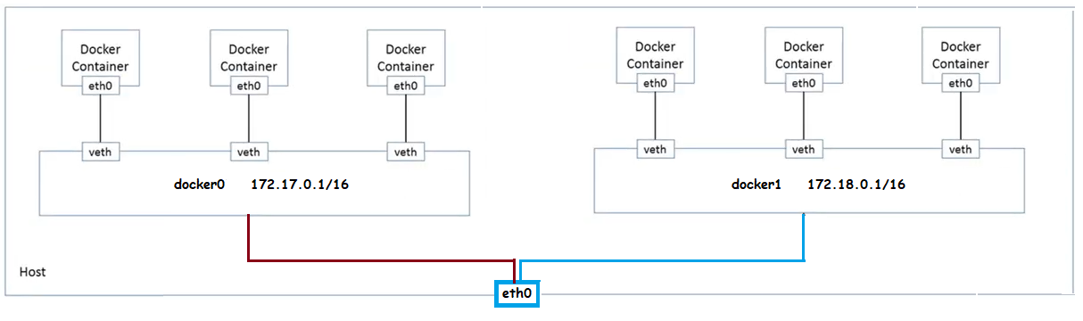
Docker
Bridge networking

Slide 47
Docker
Host networking: If you use the host network mode for a container, that container’s network stack is not isolated from the Docker host (the container shares the host’s networking namespace), and the container does not get its own IP-address allocated. For instance, if you run a container which binds to port 80 and you use host networking, the container’s application is available on port 80 on the host’s IP address.
For more info, visit to https://docs.docker.com/network/host/

Slide 48
Docker
None networking: This mode will not configure any IP for the container and doesn’t have any access to the external network as well as for other containers. It does have the loopback address and can be used for running batch jobs.

Slide 49
Docker
Docker networking: connect one or two network to a running container using connect command.

Slide 50
Docker
Docker Registry/Repository : Create your own private docker registry for your organization.

Slide 51
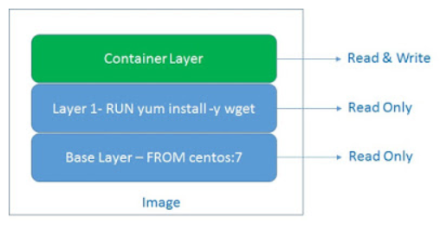
Docker
A Docker image consists of several layers. Each layer corresponds to certain instructions in your Dockerfile. For example create a layer: RUN, COPY, ADD.

Slide 52
Docker
Docker compose.
Compose is a tool for defining and running multi-container Docker applications. With Compose, you use a YAML file to configure your application’s services. Then, with a single command, you create and start all the services from your configuration.
https://docs.docker.com/compose/

Slide 53
Docker
Install Docker compose.
https://docs.docker.com/compose/install/

Slide 54
Docker
Docker compose: Create my first docker-compose file in yaml language.

Slide 55
Docker
Docker compose: Learn basic commands.
docker-compose up
docker-compose down
docker-compose create
docker-compose start
docker-compose stop
docker-compose rm

Slide 56
Docker
Docker compose: Learn basic commands.
docker-compose images
docker-compose ps
docker-compose pause
docker-compose unpause

Slide 57
Docker
Docker compose:
Build an image

Slide 58
Advanced Storage Features
Prerequisites
PC or Laptop with internet Connection
RHEL6,7,8 or CentOS, VMware Workstation & Oracle VirtualBox
Red Hat Certified System Administrator (RHCSA) Certification or equivalent experience.

Slide 59
Advanced Storage Features
Stratis is one of the new features that ships with RHEL 8 distribution.
Stratis is a local storage management solution that focuses on simplicity and improved usability while at the same time providing access to advanced storage features.
It uses Linux’s device mapper subsystem and the XFS filesystem. Stratis also gives you access to advanced storage features such as:
Thin provisioning.
File system snapshots.
Pool-based management.
Monitoring.
Stratis

Slide 60
Advanced Storage Features
In Stratis, file systems are built from shared pools of disk devices using a concept known as thin provisioning. Instead of immediately allocating physical storage space to the file system when it is created, Stratis dynamically allocates that space from the pool as the file system stores more data. Therefore, the file system might appear to be 1 TiB in size, but might only have 100 GiB of real storage actually allocated to it from the pool.
Stratis

Slide 61
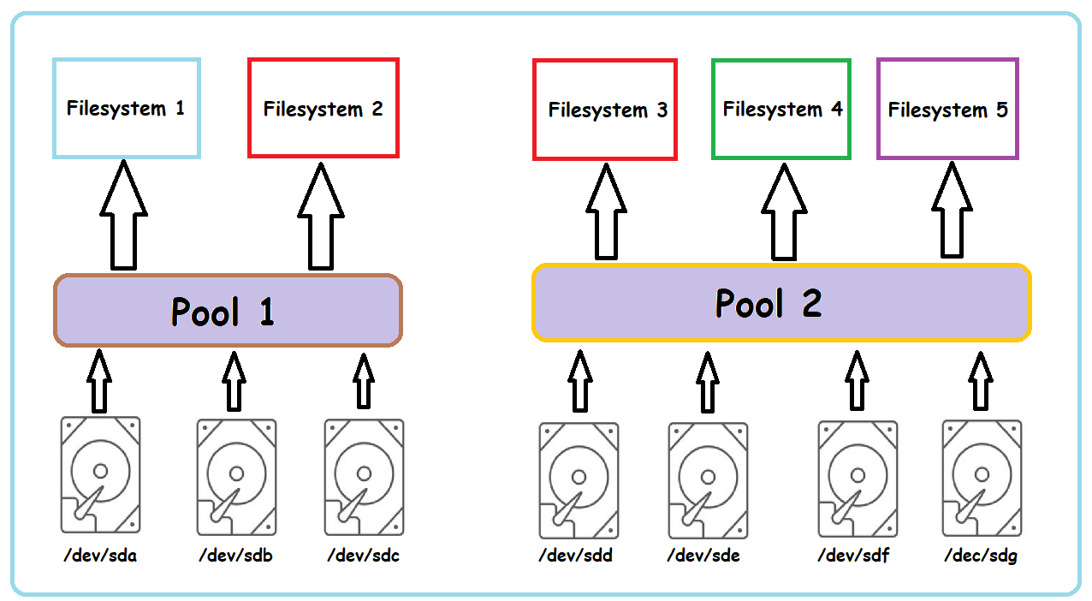
Advanced Storage Features

Slide 62
Advanced Storage Features
Lab Session
Stratis

Slide 63
Advanced Storage Features
Lab Session
VDO

Slide 64
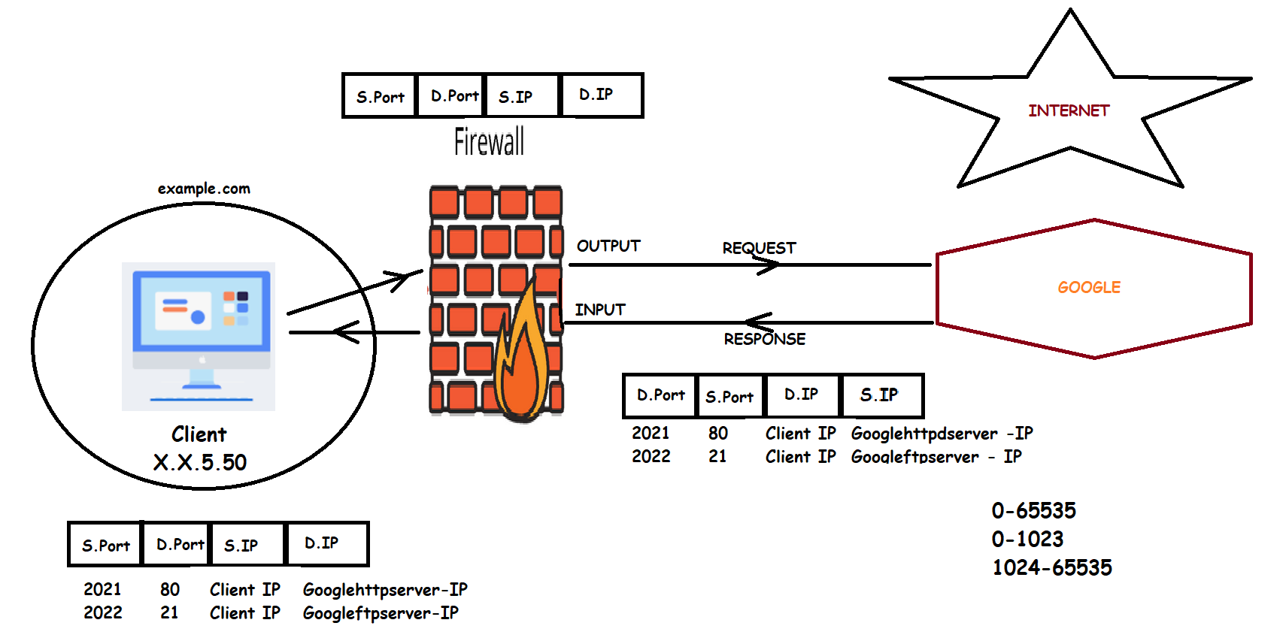

Manage Network Security

Slide 65
Managing Server Firewalls
Lab Session
Firewall Server: firewallserver.example.com (192.168.209.129)
Client Server: clientserver.example.com (192.168.209.128)

Slide 66
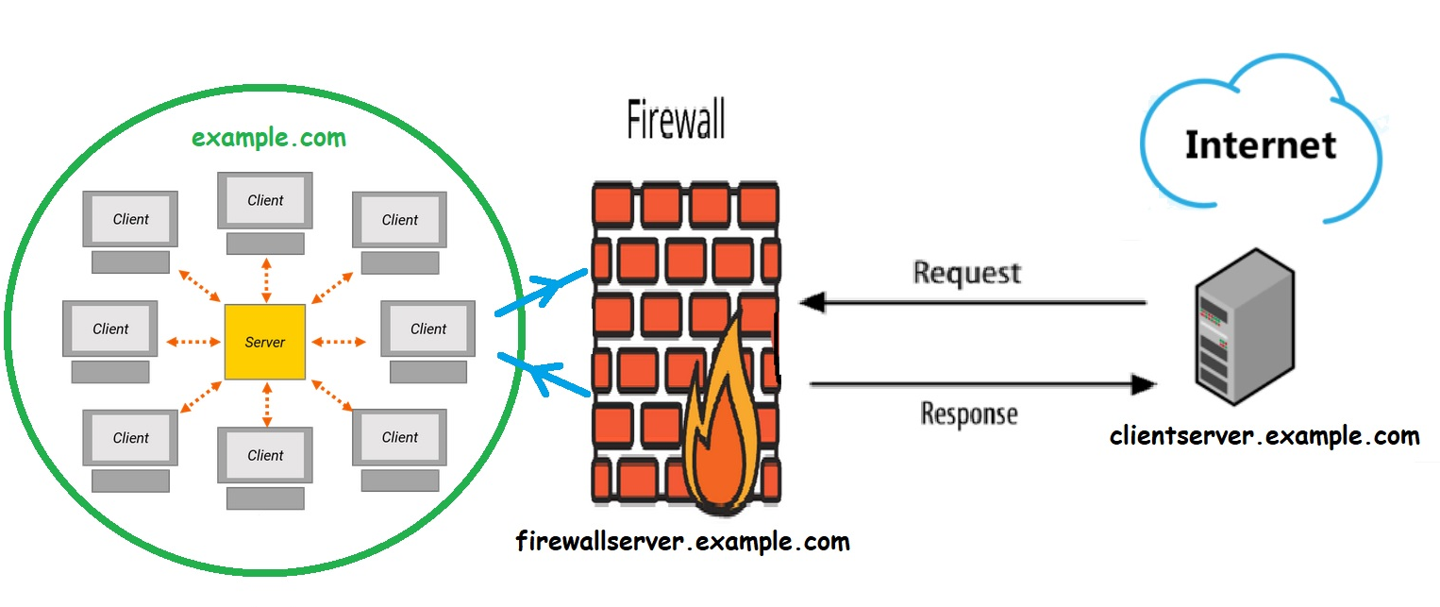
Managing Server Firewalls
(192.168.209.128)
(192.168.209.129)

Slide 67
Advanced Storage Features
➔ Guided Exercise
Create a thin-provisioned file system using Stratis storage management solution.
Verify that the file system grows dynamically to support real-time data growth.
Create a snapshot of the file system and then show you how to access the data from the snapshot of a thin-provisioned file system.
Stratis

Slide 68
Ansible Automation
Ansible is an open-source software provisioning, configuration management, and application-deployment tool. It runs on many Unix-like systems, and can configure both Unix-like systems as well as Microsoft Windows.
Ansible was originally written by Michael DeHaan, the creator of the Cobbler provisioning application. Ansible has been widely adopted, because it is simple to use for system administrators. Developers ease into using Ansible because it is built on Python.
Ansible is included as part of the Fedora distribution of Linux, owned by Red Hat, and is also available for Red Hat Enterprise Linux, CentOS, Debian, Scientific Linux, Oracle Linux via Extra Packages for Enterprise Linux (EPEL).
What is Ansible

Slide 69
Ansible Automation
Ansible's architecture is agentless. Work is pushed to remote hosts when Ansible executes. Modules are the programs that perform the actual work of the tasks of a play. Ansible is immediately useful because it comes with hundreds of core modules that perform useful system administrative work.
Instead of writing custom, individualized scripts, system administrators create high-level plays in Ansible. A play performs a series of tasks on the host, or group of hosts, specified in the play. A file that contains one or more plays is called a playbook.
What is Ansible

Slide 70
Ansible Automation
Ansible can add packages to an installation, but it does not perform the initial installation of the system. Every system can start with a minimal installation, either via Kickstart or a base cloud starter image, then use Ansible for further configuration.
Although Ansible can remediate configuration drift, it does not monitor for it.
Ansible does not track what changes are made to files on the system, nor does it track what user or process made those changes.
Ansible Limitations

Slide 71
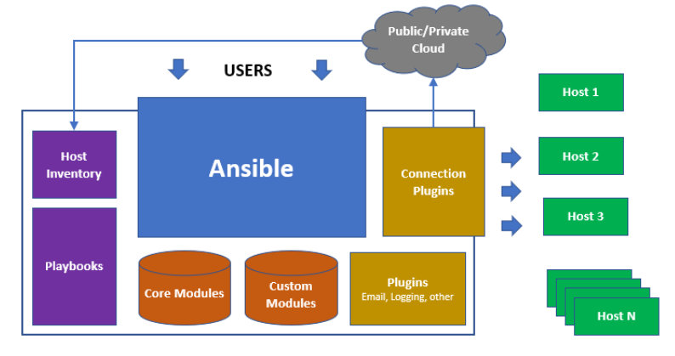
Ansible Automation

Slide 72
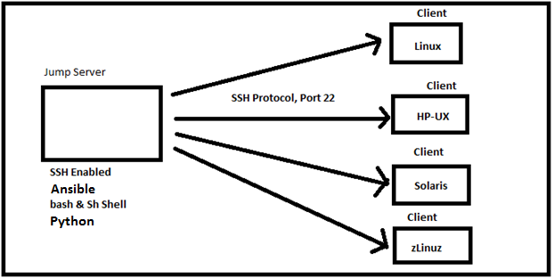
Ansible Automation

Slide 73
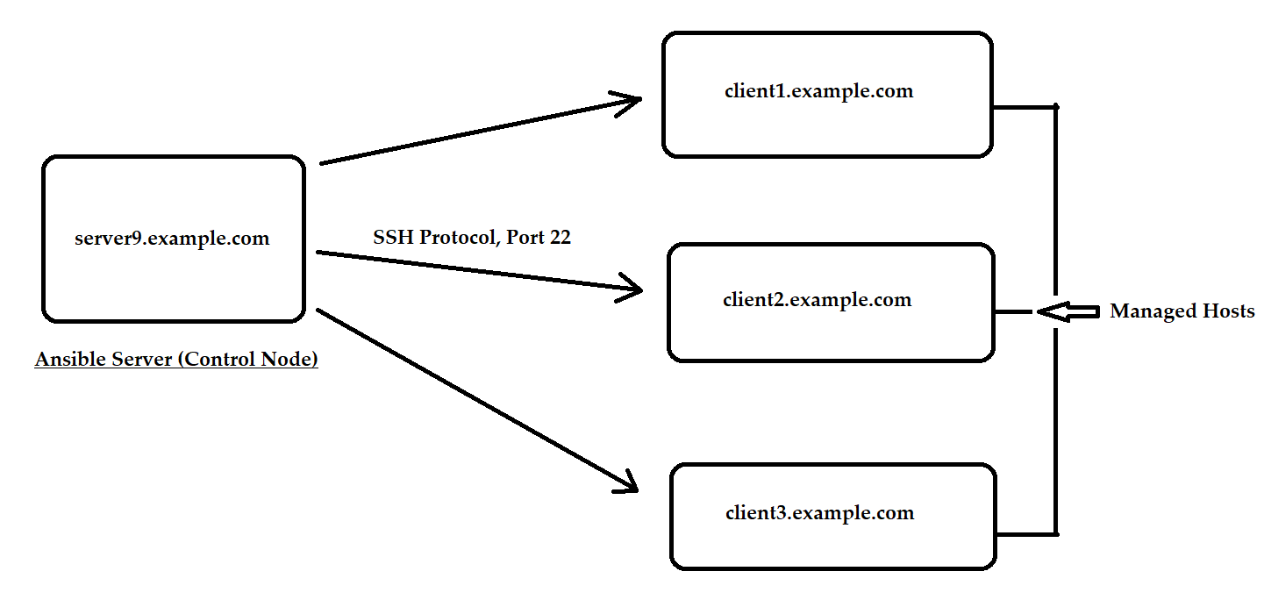
Ansible Automation
Linux, HP-UX,
Solaris, AIX,
zLinux, CentOS
Windows etc

Slide 74
Ansible Automation
It is a free open source software.
Agent-less – No need for agent installation.
Phython/yaml based.
Highly flexible and configuration management of systems.
Large number of ready to use modules for system management.
Custom modules can be added if needed.
Configuration roll-back in case of error .
Simple and human readable.
Implement Sudo passwd, so that normal needs password to elevate his privilege.
Important Points

Slide 75
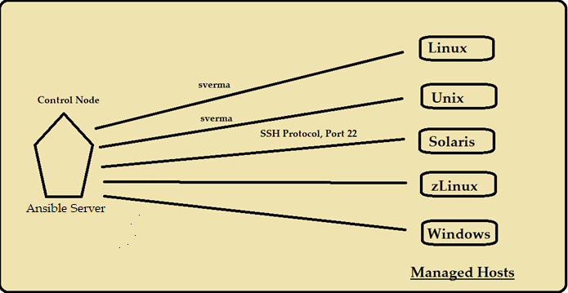
Ansible Automation
Ansible Server – ansibleser.example.com
Managed Hosts – client1, client2, client3

Slide 76
Ansible Automation
Ansible Components
Host
Inventory
Core Modules
Custom Modules
Ansible
Configuration
Playbooks
Connection
Plugins
Plugins

Slide 77
Ansible Automation
System administrators log in and initiate all Ansible operations from the control node. Ansible software is installed on the control node. Ansible configuration files are also maintained on the control node.
A machine acting as a control node must have Python 2.6 or 2.7 installed. This includes Linux, OS/X, and any BSD based Unix system. Windows is not supported for the control node at this time.
Role and requirements for the control node

Slide 78
Ansible Automation
A managed host is a system that Ansible logs into, installs modules, and executes remote commands to perform configuration tasks. Other names for a managed host include managed node and remote node.
Ansible uses SSH to communicate with managed hosts, so SSH must be installed and configured to allow incoming connections. Managed hosts must have Python 2.4 or later installed to run Ansible, which includes Red Hat Enterprise Linux 5, 6, and 7 hosts.
The python-simplejson package must also be installed on Red Hat Enterprise Linux 5 managed hosts. It is not required on Red Hat Enterprise Linux 6 and 7 managed hosts, since Python 2.5 (and newer versions) provide its functionality by default.
Role and requirements for the Managed Hosts

Slide 79
Ansible Automation
Host Inventory defines which hosts Ansible manages. Hosts may belong to groups which are typically used to identify the hosts' role in the datacenter. A host can be a member of more than one group.
[webservers]
localhost ansible_connection=local
web1.example.com
web2.example.com:1234 ansible_connection=ssh ansible_user=ftaylor
[db-servers]
web1.example.com
db1.example.com
Ansible Host Inventories

Slide 80
Ansible Automation
Customizing Ansible

Slide 81
Ansible Automation
Ansible Server – ansibleser.example.com
Managed Hosts – client1, client2, client3

Slide 82
Ansible Automation
The behavior of an Ansible installation can be customized by modifying settings housed in
ansible's configuration file (/etc/ansible/ansible.cfg).
privilege_escalation section in the ansible.cfg configuration file by adding the following entry.
[privilege_escalation]
Enable privilege escalation by adding the become setting and configuring it as True.
become=True
Customizing Ansible

Slide 83
Ansible Automation
Set the privilege escalation to use sudo by adding the become_method setting and configuring it as sudo.
become_method=sudo
Set the privilege escalation user by adding the become_user setting and configuring it as root.
become_user=root
Enable password prompting during privilege escalation by adding the become_ask_pass setting and configuring it as True.
become_ask_pass=True
Customizing Ansible

Slide 84
Ansible Automation
The command module allows administrators to quickly execute remote commands on managed hosts. These commands are not processed by the shell on the managed hosts. As such, they cannot access shell environment variables or perform shell operations such as redirection and piping.
For situations where commands require shell processing, administrators can use the shell module.
The following example illustrates the difference between the command and shell modules. If an attempt is made to execute the bash built-in, set, with these two modules, it will only succeed with the shell module.
Command & Shell Module

Slide 85
Ansible Automation
[student@demo ~]$ ansible localhost -m command -a set
localhost | FAILED | rc=2 >>
[Errno 2] No such file or directory
[student@demo ~]$ ansible localhost -m shell -a set
localhost | SUCCESS | rc=0 >>
BASH=/bin/sh
BASHOPTS=cmdhist:extquote:force_fignore:hostcomplete:interact
ive_comments:progcomp:promptvars:sourcepath
BASH_ALIASES=()
Command & Shell Module

Slide 86
Ansible Automation
Lab Session
Customizing Ansible

Slide 87
Ansible Automation
Goal: Write Ansible plays and execute a playbook.
Objective
Write YAML files.
Implement Ansible playbooks.
Write and execute a playbook.
Implementing Playbooks

Slide 88
Ansible Automation
Playbooks are the files where Ansible code is written. Playbooks are written in YAML format. Playbooks are one of the core features of Ansible and tell Ansible what to execute.
Ansible uses YAML syntax for expressing Ansible playbooks because it is very easy for humans to understand, read and write than other common data formats like XML or JSON.
Each playbook is an aggregation of one or more plays in it. Playbooks are structured using plays. There can be more than one play inside a playbook.
Implementing Playbooks

Slide 89
Ansible Automation
YAML SYNTAX
YAML files optionally begin with a three dash start of document marker and are optionally terminated with a three dot end of file marker.
---
...output omitted...
...
Implementing Playbooks

Slide 90
Ansible Automation
YAML SYNTAX
---
- hosts: dev
become: true
become_user: root
tasks:
- name: run the script
script: /home/sverma/ansible/scr.sh
when: ansible_distribution == "RedHat" and ansible_distribution_major_version == '7'
Implementing Playbooks

Slide 91
Ansible Automation
Modules are programs that Ansible uses to perform operations on managed hosts. They are ready-to-use tools designed to perform specific operations. Modules can be executed from the ansible command line or used in playbooks to execute tasks. When run, modules are copied to the managed host and executed there.
Ansible comes packaged with over 500 modules available for use. These prepackaged modules can be used to perform a wide range of tasks, such as cloud, user, package, and service management.
Introduction to modules

Slide 92
Ansible Automation
There are three types of Ansible modules:
Core modules are included with Ansible and are written and maintained by the Ansible development team. Core modules are the most important modules and are used for common administration tasks.
Extras modules are currently included with Ansible but may be promoted to core or shipped separately in the future. They are generally not maintained by the Ansible team but by the community. Typically, these modules implement features for managing newer technologies such as OpenStack.
Custom modules are modules developed by end users and not shipped by Ansible. If a module does not already exist for a task, an administrator can write a new module to implement it.
Introduction to modules

Slide 93
Ansible Automation
Core and Extras modules are always available. Ansible looks for custom modules on the control node in directories defined by the $ANSIBLE_LIBRARY environment variable
#library = /usr/share/my_modules/
On Red Hat Enterprise Linux 7,8 systems, modules are installed in the below location:
/usr/lib/pythonx.x/site-packages/ansible/modules directory.
Introduction to modules

Slide 94
Ansible Automation
Module categories
For better organization and management, Ansible modules are grouped into the following functional categories.
Module categories
• Cloud • Files • Notification
• Packaging • Source Control • System
• Utilities • Web Infrastructure • Windows
• Clustering • Inventory • Messaging • Monitoring
• Network • Commands • Database
Introduction to modules

Slide 95
Ansible Automation
Lab Session
Modules

Slide 96
Ansible Automation
Writing a playbook
If multiple tasks are desired, the same syntax is repeated for each task.
tasks:
- name: first task
service: name=httpd enabled=true
- name: second task
service: name=sshd enabled=true
...output omitted...
- name: last task
service: name=sshd enabled=true
Introduction to modules

Slide 97
Ansible Automation
Important
When possible, try to avoid the command, shell, and raw modules in playbooks because these take arbitrary commands, it is very easy to write non-idempotent playbooks with these modules.
For example, this task using the shell module is not idempotent. Every time the play is run, it will rewrite /etc/resolv.conf even if it already consists of the line "nameserver 192.0.2.1".
- name: Non-idempotent approach with shell module
shell: echo "nameserver 192.0.2.1" > /etc/resolv.conf
Writing a playbook

Slide 98
Ansible Automation
The following example will not rewrite the file /etc/resolv.conf if it already consists of the right content:
- name: Idempotent approach with copy module
copy:
dest: /etc/resolv.conf
content: "nameserver 192.0.2.1\n"
The copy module is special-purpose and can easily test to see if the state has already been met, and if it has will make no changes.
Idempotent playbooks can be run repeatedly to ensure systems are in a particular state without disrupting those systems if they already are.
Writing a playbook

Slide 99
Ansible Automation
If multiple tasks are desired, the same syntax is repeated for each task.
tasks:
- name: first task
service: name=httpd enabled=true
- name: second task
service: name=sshd enabled=true
...output omitted...
- name: last task
service: name=sshd enabled=true
Writing a playbook

Slide 100
Ansible Automation
Lab Session
Writing a playbook

Slide 101
Ansible Automation
Lab Session
Implementing Multi tasks in Playbook
Package Installation (Apache/FTP)
Mount OS Media Drive
Create local repository
Install required Packages
Enabled the service
Start the Service
Client1
Ansible Server
Client2

Slide 102
Ansible Automation
Ansible supports variables that can be used to store values that can be reused throughout files in an entire Ansible project.
Variables provide a convenient way to manage dynamic values for a given environment in your ansible project. Some examples of values that variables might contain include.
Users to create
Packages to install
Services to restart
Files to remove
Managing Variables

Slide 103
Ansible Automation
Naming variables
Variables have names which consist of a string that must start with a letter and can only contain letters, numbers, and underscores.
Defining variables
Variables can be defined in a variety of places in an Ansible project. However, this can be simplified to three basic scope levels:
• Global scope: Variables set from the command line or Ansible configuration
• Play scope: Variables set in the play and related structures
• Host scope: Variables set on host groups and individual hosts by the inventory, fact gathering, or registered tasks
Managing Variables

Slide 104
Ansible Automation
Variables in playbooks
When writing playbooks, administrators can use their own variables and call them in a task.
For example, a variable web_package can be defined with a value of httpd and called by the yum module in order to install the httpd package as shown in next slide.
Managing Variables

Slide 105
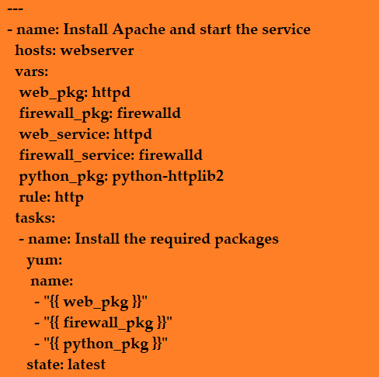
Ansible Automation
Managing Variables

Slide 106
Ansible Automation
Host Variables and Group Variables
Inventory variables that apply directly to hosts fall into two broad categories: host variables that apply to a specific host, and group variables that apply to all hosts in a host group or in a group of host groups. Host variables take precedence over group variables, but variables defined by a playbook take precedence over both.
This is a host variable, ansible_user, being defined for the host demo.example.com.
[servers]
demo.example.com ansible_user=joe
Managing Variables

Slide 107
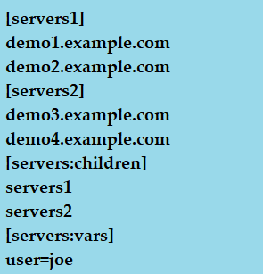
Ansible Automation
Host Variables and Group Variables
Managing Variables

Slide 108
Ansible Automation
Ansible facts are variables that are automatically discovered by Ansible from a managed host.
Facts are pulled by the setup module and contain useful information stored into variables that administrators can reuse. Ansible facts can be part of playbooks, in conditionals, loops, or any other dynamic statement that depends on a value for a managed host;
For example:
A server can be restarted depending on the current kernel version.
Users can be created depending on the host name.
Ansible facts

Slide 109
Ansible Automation
Ansible facts are a convenient way to retrieve the state of a managed node and decide which action to take based on its state. Facts provide information about
The host name
The kernel version
The network interfaces
The IP addresses
The version of the operating system
Various environment variables
The number of CPUs
The available or free memory
Ansible facts

Slide 110
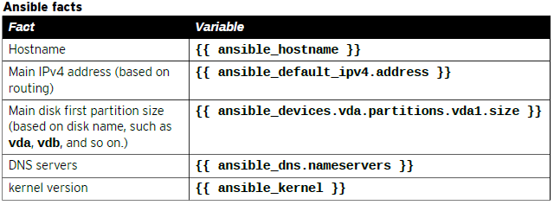
Ansible Automation
The following shows some of the facts Ansible gathered from a managed node:
[user@demo ~]$ ansible demo1.example.com -m setup
Ansible facts

Slide 111
Ansible Automation
Ansible can use conditionals to execute tasks or plays when certain conditions are met. For example, a conditional can be used to determine the available memory on a managed host before Ansible installs or configures a service.
The following examples illustrate some ways in which conditionals can be used by Ansible.
A hard limit can be defined in a variable (for example, min_memory) and compare it against the available memory on a managed host.
Ansible facts can be used to determine the managed host network configuration and decide which template file to send (for example, network bonding or trunking).
Conditionals

Slide 112
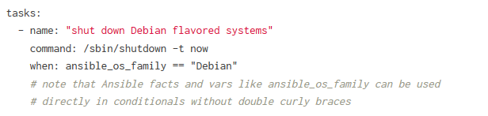
Ansible Automation
The When Statement
Sometimes you will want to skip a particular step on a particular host. This could be something as simple as not installing a certain package if the operating system is a particular version, or it could be something like performing some cleanup steps if a filesystem is getting full.
Conditionals

Slide 113
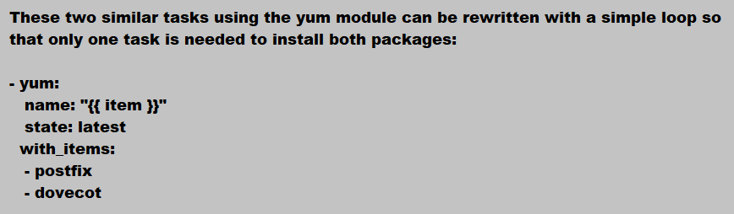
Ansible Automation
- yum:
name: postfix
state: latest
- yum:
name: dovecot
state: latest
Loops in Ansible

Slide 114
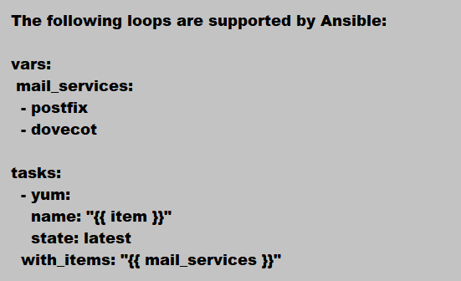
Ansible Automation
Loops in Ansible

Slide 115
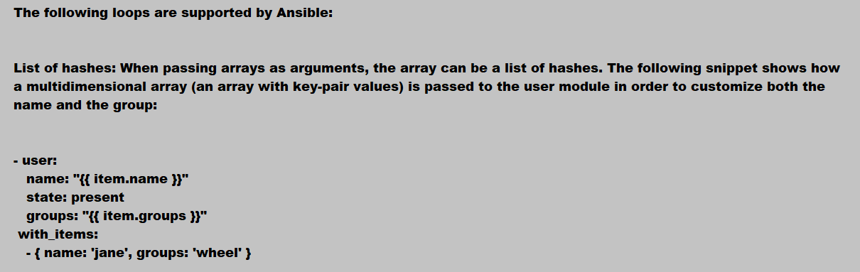
Ansible Automation
Loops in Ansible

Slide 116
Ansible Automation
Practice Lab Session
Loops in Ansible

Slide 117
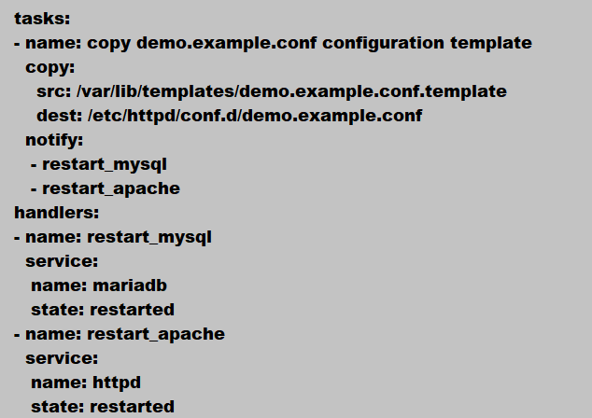
Ansible Automation
A Handler is exactly the same as a task, but it will run when called by another task. A Handler will take an action when called by an event it listens for.
Ansible Handlers

Slide 118
Ansible Automation

Slide 119
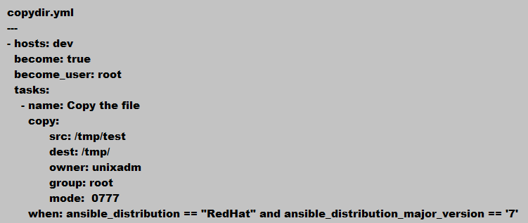
Ansible Automation
Conditionals

Slide 120
Ansible Automation
Verify the Application/Database processes are running or not.
Decision point to start patching.
Copy the required Repo file to the Managed host.
Upgrade the Kernel or Packages.
Check if reboot is required after kernel update.
Reboot the system.
Wait for few minutes, so that server should come up after reboot.
Debug a message with new kernel version
Patching On Linux Servers using Ansible
Patching

Slide 121
Ansible Automation
Ansible is a radically simple IT automation platform that makes your applications and systems easier to deploy.
It support configuration management with examples as below.
Configuration of servers
Application deployment
Continuous testing of already install application
Provisioning
Orchestration
Automation of tasks
Introduction

Slide 122
Red Hat System Administration II – SA2
Practice Lab Session
Bash Scripts

Slide 123
Red Hat System Administration II – SA2
Scheduling Future Tasks
Agenda
Set up a command that runs once at some point in the future
Schedule commands to run on a repeating schedule using a user’s crontab file.
Schedule commands to run on a repeating schedule using the system crontab file and directories.
Enable and disable systemd timers, and configure a timer that manages temporary files.

Slide 124
Red Hat System Administration II – SA2
On Unix-like operating systems, the at, batch, atq, and atrm commands can schedule a command or commands to be executed at a specified time in the future.
Sometimes you might need to run a command, or set of commands, at a set point in the future. Examples include people who want to schedule an email to their boss, or a system administrator working on a firewall configuration who puts a “safety” job in place to reset the firewall settings in ten minutes' time, unless they deactivate the job beforehand.
These scheduled commands are often called tasks or jobs, and the term deferred indicates that these tasks or jobs are going to run in the future.
Scheduling Future Tasks

Slide 125
Red Hat System Administration II – SA2
Use the at TIMESPEC command to schedule a new job.
at now +5min < myscript
The following lists some examples of combinations that can be used.
now +3min
teatime tomorrow (teatime is 16:00)
noon +4 days
5pm august 3 2021
Scheduling Future Tasks

Slide 126
Red Hat System Administration II – SA2
Commands used with at:
at: execute commands at specified time.
atq or at –l : lists the pending jobs for users
atrm: delete jobs by their job number.
Scheduling Future Tasks

Slide 127
Red Hat System Administration II – SA2
For instance, let's assume the current time is 10:00 AM, Tuesday, October 18, 2019.
noon 12:00 PM October 18 2019
midnight 12:00 AM October 19 2019
teatime 04:00 PM October 18 2019
tomorrow 10:00 AM October 19 2019
noon tomorrow 12:00 PM October 19 2019
next week 10:00 AM October 25 2019
next monday 10:00 AM October 24 2019
Scheduling Future Tasks

Slide 128
Red Hat System Administration II – SA2
Controlling Nice Values with Queue Designations
You can control the niceness or nice value of a scheduled job by using a queue designation. A niceness of -20 is the highest priority and 19 is the lowest priority.
Valid queue designations range from a to z, with a being the default queue and b being reserved for batch jobs.
Jobs scheduled with a higher queue designation run with an increased niceness. As a result they will run with a lower CPU priority than other processes.
Scheduling Future Tasks

Slide 129
Red Hat System Administration II – SA2
Controlling Nice Values with Queue Designations
Here is an example of scheduling a job with a increased niceness. Most importantly this is useful when a system has several high CPU demand processes running and you do not want to interrupt those processes.
$ echo "nicetest.sh" | at -q h noon
Scheduling Future Tasks

Slide 130
Red Hat System Administration II – SA2
Scheduling Recurring System Jobs
System administrators often need to run recurring jobs. Best practice is to run these jobs from system accounts rather than from user accounts. That is, do not schedule to run these jobs using the crontab command, but instead use system-wide crontab files.
Job entries in the system-wide crontab files are similar to those of the users' crontab entries, excepting only that the system-wide crontab files have an extra field before the command field; the user under whose authority the command should run.
Scheduling Future Tasks

Slide 131
Red Hat System Administration II – SA2
Scheduling Recurring System Jobs
Recurring System Jobs are defined in two locations : /etc/crontab file and files within the /etc/cron.d/ directory.
The crontab system also includes repositories for scripts that need to run every hour, day, week, and month. Such as /etc/cron.hourly/, /etc/cron.daily/, /etc/cron.weekly/, and /etc/cron.monthly/
Scheduling Future Tasks

Slide 132
Red Hat System Administration II – SA2
Scheduling Recurring System Jobs
Practice Lab Session
Scheduling Future Tasks

Slide 133
Red Hat System Administration II – SA2
Scheduling tasks with Systemd Timer
With the advent of systemd in Red Hat Enterprise Linux 7, a new scheduling function is now available: systemd timer units. A systemd timer unit activates another unit of a different type (such as a service) whose unit name matches the timer unit name. The timer unit allows timer-based activation of other units. For easier debugging, systemd logs timer events in system journals.
The sysstat package provides a systemd timer unit called sysstat-collect.timer to collect system statistics every 10 minutes. The following output shows the configuration lines of /usr/lib/systemd/system/sysstat-collect.timer.
Scheduling Future Tasks

Slide 134
Red Hat System Administration II – SA2
Scheduling tasks with Systemd Timer
Practice Lab Session
Scheduling Future Tasks

Slide 135
Red Hat System Administration II – SA2
Managing Temporary Files
A modern system requires a large number of temporary files and directories. Some applications (and users) use the /tmp directory to hold temporary data, while others use a more task-specific location such as daemon and user-specific volatile directories under /run . In this context, volatile means that the file system storing these files only exists in memory. When the system reboots or loses power, all the contents of volatile storage will be gone.
Red Hat Enterprise Linux 7 and later include a new tool called systemd-tmpfiles , which provides a structured and configurable method to manage temporary directories and files.
Scheduling Future Tasks

Slide 136
Red Hat System Administration II – SA2
Managing Temporary Files
When systemd starts a system, one of the first service units launched is systemd-tmpfiles-setup . This service runs the command systemd-tmpfiles --create --remove . This command reads configuration files from /usr/lib/tmpfiles.d/*.conf , /run/tmpfiles.d/*.conf , and /etc/tmpfiles.d/*.conf . Any files and directories marked for deletion in those configuration files is removed, and any files and directories marked for creation (or permission fixes) will be created with the correct permissions if necessary.
[root@server1 /]# systemctl status systemd-tmpfiles-setup.service
Scheduling Future Tasks

Slide 137
Red Hat System Administration II – SA2
Cleaning Temporary Files with a Systemd Timer
To ensure that long-running systems do not fill up their disks with stale data, a systemd timer unit called systemd-tmpfiles-clean.timer triggers systemd-tmpfiles-clean.service on a regular interval, which executes the systemd-tmpfiles --clean command. This command reads configuration files from /usr/lib/tmpfiles.d/*.conf , /run/tmpfiles.d/*.conf , and /etc/tmpfiles.d/*.conf .
[root@server1 /]# /usr/lib/systemd/system/systemd-tmpfiles-clean.timer
[root@server1 /]# cat /usr/lib/systemd/system/systemd-tmpfiles-clean.service
Scheduling Future Tasks

Slide 138
Red Hat System Administration II – SA2
Cleaning Temporary Files with a Systemd Timer
The basic syntax consists of seven columns: Type, Path, Mode, UID, GID, Age, and Argument.
The following are some examples with explanations.
d /run/systemd/seats 0755 root root -
D /home/student 0700 student student 1d
L /run/fstablink - root root - /etc/fstab
Scheduling Future Tasks

Slide 139
Red Hat System Administration II – SA2
Practice Lab Session
Configure systemd-tmpfiles to remove unused temporary files from /tmp .
If a file in /run/tmpfiles.d/ has the same file name as a file in /usr/lib/tmpfiles.d/ , then the file in /run/tmpfiles.d/ is used. If a file in /etc/tmpfiles.d/ has the same file name as a file in either /run/tmpfiles.d/ or /usr/lib/tmpfiles.d/ , then the file in /etc/tmpfiles.d/ is used.
Scheduling Future Tasks

Slide 140
Red Hat System Administration II – SA2
Practice Lab Session
Configure systemd-tmpfiles to periodically purge files from another directory.
If a file in /run/tmpfiles.d/ has the same file name as a file in /usr/lib/tmpfiles.d/ , then the file in /run/tmpfiles.d/ is used. If a file in /etc/tmpfiles.d/ has the same file name as a file in either /run/tmpfiles.d/ or /usr/lib/tmpfiles.d/ , then the file in /etc/tmpfiles.d/ is used.
Scheduling Future Tasks

Slide 141
Red Hat System Administration II – SA2
Adjusting Tuning Profiles
Agenda
Optimize system performance by selecting a tuning profile managed by the tuned daemon.
Adjusting scheduling priority of processes.

Slide 142
Red Hat System Administration II – SA2
System administrators can optimize the performance of a system by adjusting various device settings based on a variety of use case workloads. The tuned daemon applies tuning adjustments both statically and dynamically.
As a system administrator, you can use the Tuned application to optimize the performance profile of your system for a variety of use cases.
Tuned is a service that monitors your system and optimizes the performance under certain workloads. The core of Tuned are profiles, which tune your system for different use cases.
Adjusting Tuning Profiles

Slide 143
Red Hat System Administration II – SA2
For example, the hard drive is used heavily during startup and login, but is barely used later when the user might mainly work with applications such as web browsers or email clients. Similarly, the CPU and network devices are used differently at different times. Tuned monitors the activity of these components and reacts to the changes in their use.
On a typical office workstation, the Ethernet network interface is inactive most of the time. Only a few emails go in and out or some web pages might be loaded. For those kinds of loads, the network interface does not have to run at full speed all the time, as it does by default. Tuned has a monitoring and tuning plug-in for network devices that can detect this low activity and then automatically lower the speed of that interface, typically resulting in a lower power usage.
Adjusting Tuning Profiles

Slide 144
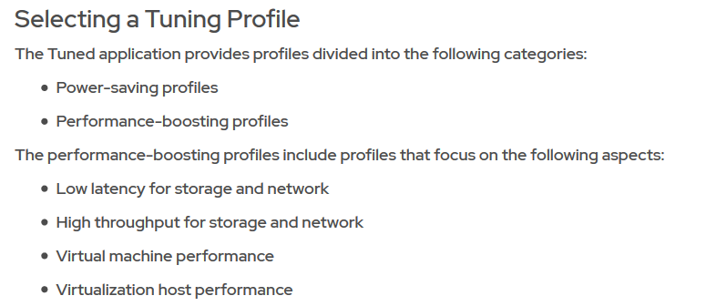
Red Hat System Administration II – SA2
Adjusting Tuning Profiles

Slide 145
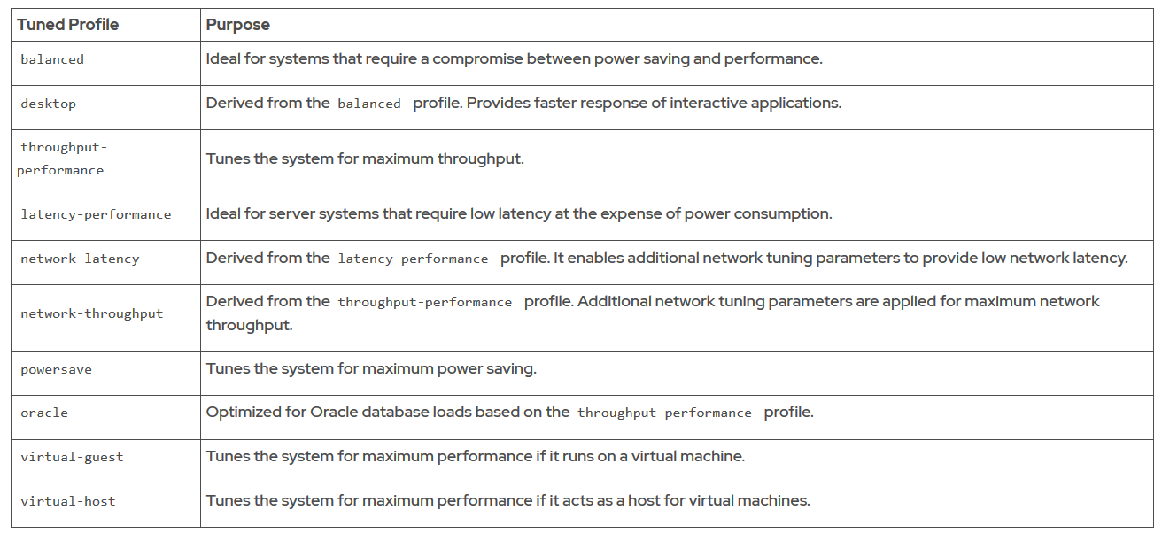
Red Hat System Administration II – SA2
Tuning Profiles Distributed with Red Hat Enterprise Linux 8

Slide 146
Red Hat System Administration II – SA2
Lab Session
Tune a server’s performance by activating the tuned service and apply a tuning profile to powersave.
Adjusting Tuning Profiles

Slide 147
Red Hat System Administration II – SA2
Modern computer systems range from low-end systems that have single CPUs that can only execute a single instruction at any instance of time, to high-performing supercomputers with hundreds of CPUs each and dozens or even hundreds of processing cores on each CPU , allowing the execution of huge numbers of instructions in parallel. All these systems still have one thing in common: the need to run more process threads than they have CPUs.
Linux and other operating systems run more processes than there are processing units using a technique called time-slicing or multitasking .
Linux Process Scheduling and Multitasking

Slide 148
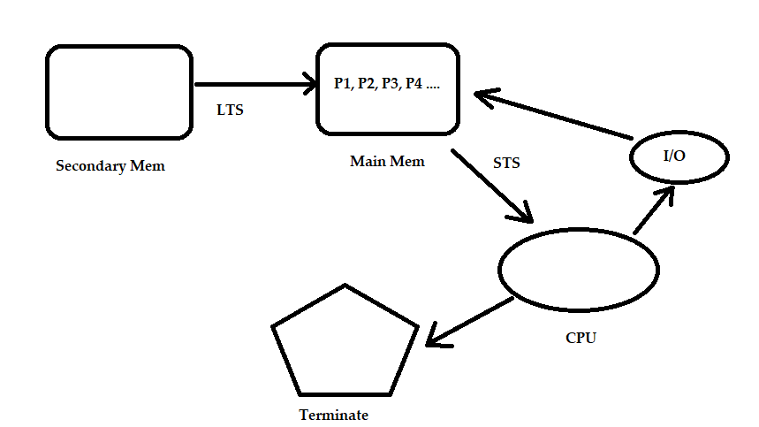
Red Hat System Administration II – SA2

Slide 149
Red Hat System Administration II – SA2
Relative Priorities
Different processes have different levels of importance. The process scheduler can be configured to use different scheduling policies for different processes. The scheduling policy used for most processes running on a regular system is called SCHED_OTHER (also called SCHED_NORMAL ), but other policies exist for various workload needs.
Since not all processes are equally important, processes running with the SCHED_NORMAL policy can be given a relative priority. This priority is called the nice value of a process, which are organized as 40 different levels of niceness for any process.
Linux Process Scheduling and Multitasking

Slide 150
Red Hat System Administration II – SA2
Relative Priorities
The nice level values range from -20 (highest priority) to 19 (lowest priority). By default, processes inherit their nice level from their parent, which is usually 0. Higher nice levels indicate less priority (the process easily gives up its CPU usage), while lower nice levels indicate a higher priority (the process is less inclined to give up the CPU).
Linux Process Scheduling and Multitasking

Slide 151
Red Hat System Administration II – SA2
Lab Session
In this exercise, we will adjust the scheduling priority of processes with the nice and renice commands and observe the effects this has on process execution.
Linux Process Scheduling and Multitasking

Slide 152
Red Hat System Administration II – SA2
Controlling Access to files with ACLs
Agenda
Describe ACLs, view and Interpret ACLs with ls and getfacl
Set and remove ACLs on files
Describe the ACL mask and ACL permissions
Identify where Red Hat Enterprise Linux uses ACLs by default.

Slide 153
Red Hat System Administration II – SA2
Access Control List Concepts
Standard Linux file permissions are satisfactory when files are used by only a single owner, and a single designated group of people. However, some use cases require that files are accessed with different file permission sets by multiple named users and groups. Access Control Lists (ACLs) provide this function.
With ACLs, you can grant permissions to multiple users and groups, identified by user name, group name, UID, or GID, using the same permission flags used with regular file permissions: read, write, and execute.
Controlling Access to files with ACLs

Slide 154
Red Hat System Administration II – SA2
Access Control List Concepts
First let us understand the purpose of each permission on files and directories
Files –
r (read) – The contents of the file can be viewed w (write) – The file can be edited and new content can be inserted x (execute) – The file can be executed
Directories –
r (read) – The contents of the directory can be viewed with the “ls” command w (write) – New file can be created inside the directory and existing files can be deleted x (execute) – The user with this permission can change directory (cd) into this directory
Controlling Access to files with ACLs

Slide 155
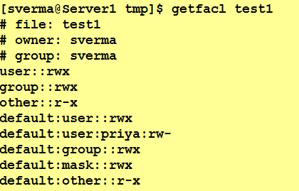
Red Hat System Administration II – SA2
To view the access control list of a file/directory, use the getfacl command
Controlling Access to files with ACLs

Slide 156
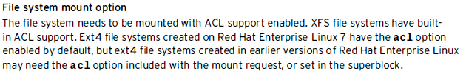
Red Hat System Administration II – SA2
File-system ACL Support
Before using the setfacl command, acl has to be enabled on the filesystem, else you’ll receive the following error.
setfacl: /path/to/file: Operation not supported
Controlling Access to files with ACLs

Slide 157
Red Hat System Administration II – SA2
Viewing and Interpreting ACL Permissions
The ls -l command only outputs minimal ACL setting details:
[sverma@server1 ~]$ ls -l test.txt
-rwxrw----+ 1 sverma unixadm 124 Apr 19 13:36 test.txt
Controlling Access to files with ACLs

Slide 158
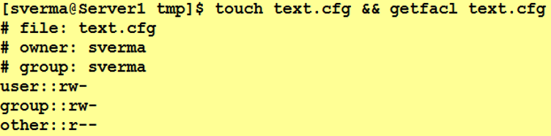
Red Hat System Administration II – SA2
Let’s see what ACLs can do for us. First we will create a file named text.cfg and we will give it as an argument to the getfacl command. Let’s see what the output of this command shows:
Controlling Access to files with ACLs

Slide 159
Red Hat System Administration II – SA2
As you can see, since we didn’t set any ACL permission on the file, the command just displays the standard permissions values, plus the file owner and the group owner, both having read and write permissions.
Now let’s imagine we want to give a specific user
[sverma@Server1 tmp]$ setfacl -m u:priya:rw text.cfg
Here, -m which allows us to change the ACL’s of a file/Directory
u stands for user, g ➔ for group or an “o” for others
priya ➔ User Name
rw ➔ Permissions
Text.cfg ➔ The name of the file on which we want to apply the permissions.
Controlling Access to files with ACLs

Slide 160
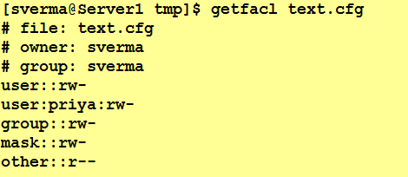
Red Hat System Administration II – SA2
Controlling Access to files with ACLs

Slide 161
Red Hat System Administration II – SA2
An entry for the user "priya" has been added and showing permissions whatever we have assigned to her. We can notice one more entry i.e. mask has appeared.
The mask associated with an ACL limits the set of permissions that can be assigned on the file for the the named groups and users and for the group owner, but has no effect on the permissions for the file owner and the other permission group.
Controlling Access to files with ACLs

Slide 162
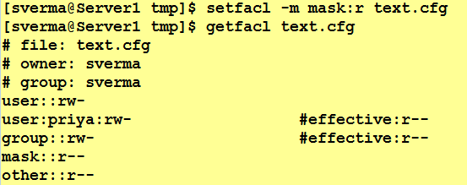
Red Hat System Administration II – SA2
In this case, only reading and writing permissions could be assigned with setfacl command. Of course we can change this option, using setfacl program itself:
setfacl -m mask:r text.cfg
Controlling Access to files with ACLs

Slide 163
Red Hat System Administration II – SA2
After changing the mask value to “r” and permissions has been effective for group owner and priya user. user have reading and writing permissions on the file, by changing the mask, we have effectively limited their permissions to read only. As the output of the command shows, they now are only allowed to read the file.
Other than explicitly changed with the command above, the ACLs mask also gets automatically re-calculated when we assign or change permissions with setfacl (unless the -n option is specified).
Controlling Access to files with ACLs

Slide 164
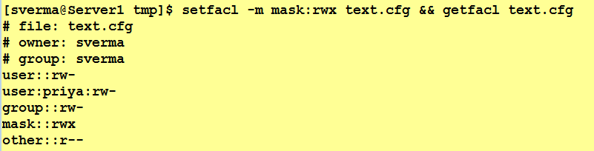
Red Hat System Administration II – SA2
Let’s demonstrate that: we will change the permissions of the priya user to rwx and then check the getfacl output:
As you can see the mask got re-calculated and it now reflects the maximum permissions present for the named user priya. Obviously, since now no previously set permissions are higher than the mask, there is no need for showing the #effective permission status.
Controlling Access to files with ACLs

Slide 165
Red Hat System Administration II – SA2
Default ACLs
The default ACL is a specific type of permission assigned to a directory, that doesn’t change the permissions of the directory itself, but makes so that specified ACLs are set by default on all the files created inside of it. Let’s demonstrate it: first we are going to create a directory and assign default ACL to it by using the -d option:
$ mkdir dir && setfacl -d -m u:dummy:rw dir
Controlling Access to files with ACLs

Slide 166
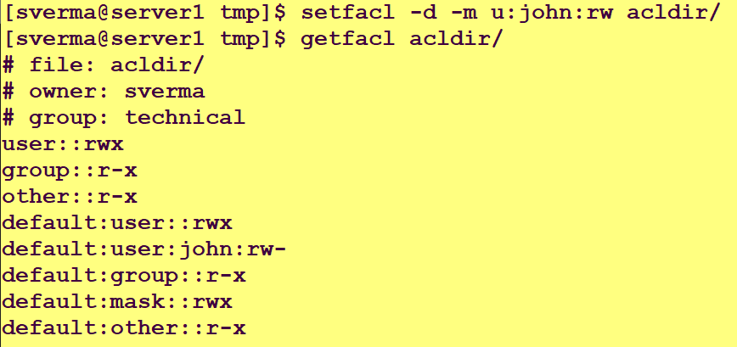
Red Hat System Administration II – SA2
Controlling Access to files with ACLs

Slide 167
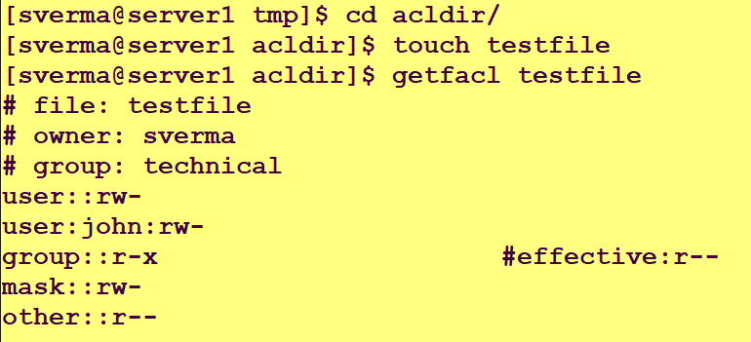
Red Hat System Administration II – SA2
Controlling Access to files with ACLs
The default permissions has been assigned correctly. Now we can verify them by creating a file inside of the test directory and checking its permissions by running getfacl:

Slide 168
Red Hat System Administration II – SA2
Controlling Access to files with ACLs
Lab Session
The mask associated with an ACL limits the set of permissions that can be assigned on the file for the the named groups and users and for the group owner, but has no effect on the permissions for the file owner and the other permission group.

Slide 169
Red Hat System Administration II – SA2
Controlling Access to files with ACLs
Lab Session
The default ACL is a specific type of permission assigned to a directory, that doesn’t change the permissions of the directory itself, but makes so that specified ACLs are set by default on all the files created inside of it. Let’s demonstrate it: first we are going to create a directory and assign default ACL to it by using the -d option:
$ mkdir dir && setfacl -d -m u:dummy:rw dir

Slide 170
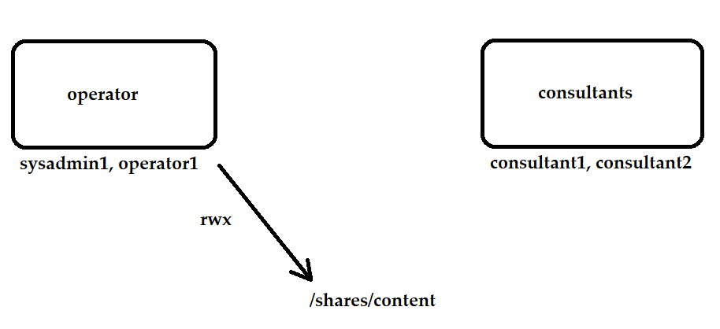
Red Hat System Administration II – SA2
Controlling Access to files with ACLs

Slide 171
Red Hat System Administration II – SA2
Managing SELinux Security
Agenda
Basic SELinux Security Concepts
How SELinux protects resources and how to select the enforcement mode.
Configure a file's SELinux context
Configure SELinux booleans
Investigate SELinux log messages and troubleshoot SELinux AVC denials.

Slide 172
Red Hat System Administration II – SA2
Managing SELinux Security
What is SELinux?
SELinux is an acronym for Security-enhanced Linux. It is a security feature of the Linux kernel.
SELinux gives you the ability to limit the privileges associated with executing processes and reduce the damage that could result from system and applications vulnerabilities exploitation.
It is designed to protect the server against misconfigurations and/or compromised daemons. It put limits and instructs server daemons or programs what files they can access and what actions they can take by defining a security policy.

Slide 173
Red Hat System Administration II – SA2
Managing SELinux Security
Basic SELinux Security Concepts
SELinux provides a critical security purpose in Linux, permitting or denying access to files and other resources that are significantly more precise than user permissions.
Security Enhanced Linux (SELinux) is an additional layer of system security. A primary goal of SELinux is to protect user data from system services that have been compromised. Most Linux administrators are familiar with the standard user/group/other permissions security model and known as discretionary access control.
SELinux provides an additional layer security that is object-based and controlled by more sophisticated rules, knows as mandatory access control.

Slide 174
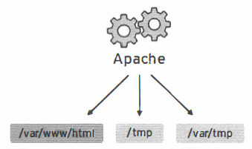
Red Hat System Administration II – SA2
Managing SELinux Security
Apache service without SELinux Protection (DAC)
To allow remote anonymous access to a webserver, firewall ports must be opened. However, this gives malicious people an opportunity to crack the system through a security exploit, and if they compromise the webserver process, gain its permissions: the permissions of the apache user and the apache group. That user/group has read access to things like the document root (Ivar/www/html), as well as write access to /tmp, /var/tmp, and any other files/directories that are world-writable.

Slide 175
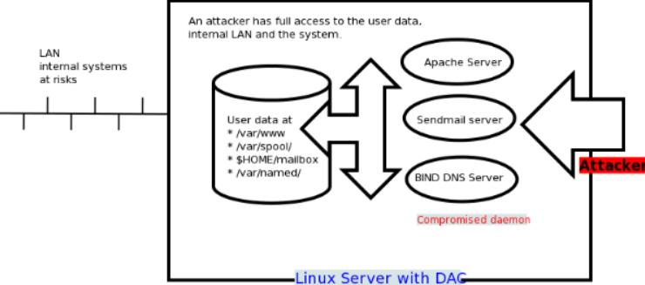
Red Hat System Administration II – SA2
Managing SELinux Security

Slide 176
Red Hat System Administration II – SA2
Managing SELinux Security
Apache service with SELinux Protection (MAC)
SELinux is a set of security rules that determine which process can access which files, directories, and ports. Every file, process, directory, and port has a special security label called a SELinux context.
It is built into the Linux kernel and enabled by default on Fedora, CentOS, RHEL and a few other Linux distributions.

Slide 177
Red Hat System Administration II – SA2
Managing SELinux Security
Apache service with SELinux Protection (MAC)
For example, an apache user with full permission can only access /var/www/html directory, but can not touch other parts of the system such as /etc directory without policy modification. If an attacker managed to gain access to sendmail mail or bind dns or apache web server, would only have access to exploited server and the files normally has access as defined in the policy for the server. An attacker can not access the other parts of the system or internal LAN. In other words, damage can be now restricted to the particular server and files. The cracker will not able to get a shell on your server via common daemons such as Apache / BIND / Sendmail as SELinux offers the following security features:

Slide 178
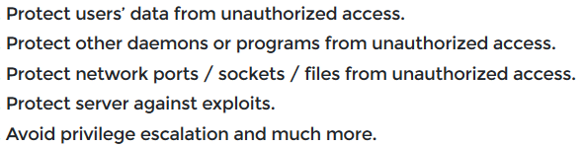
Red Hat System Administration II – SA2
Managing SELinux Security
Apache service with SELinux Protection (MAC)

Slide 179
Red Hat System Administration II – SA2
Managing SELinux Security
Apache service with SELinux Protection (MAC)
SELinux is a set of security rules that determine which process can access which files, directories, and ports. Every file, process, directory, and port has a special security label called a SELinux context.
A context is a name that is used by the SELinux policy to determine whether a process can access a file, directory, or port. By default, the policy does not allow any interaction unless an explicit rule grants access. If there is no allow rule, no access is allowed.

Slide 180
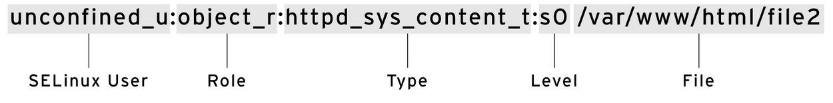
Red Hat System Administration II – SA2
Managing SELinux Security
SELinux Context
SELinux is a set of security rules that determine which process can access which files, directories, and ports. Every file, process, directory, and port has a special security label called a SELinux context.
SELinux labels have several contexts: user , role , type , and sensitivity . The targeted policy, which is the default policy enabled in Red Hat Enterprise Linux, bases its rules on the third context: the type context. Type context names usually end with _t .

Slide 181
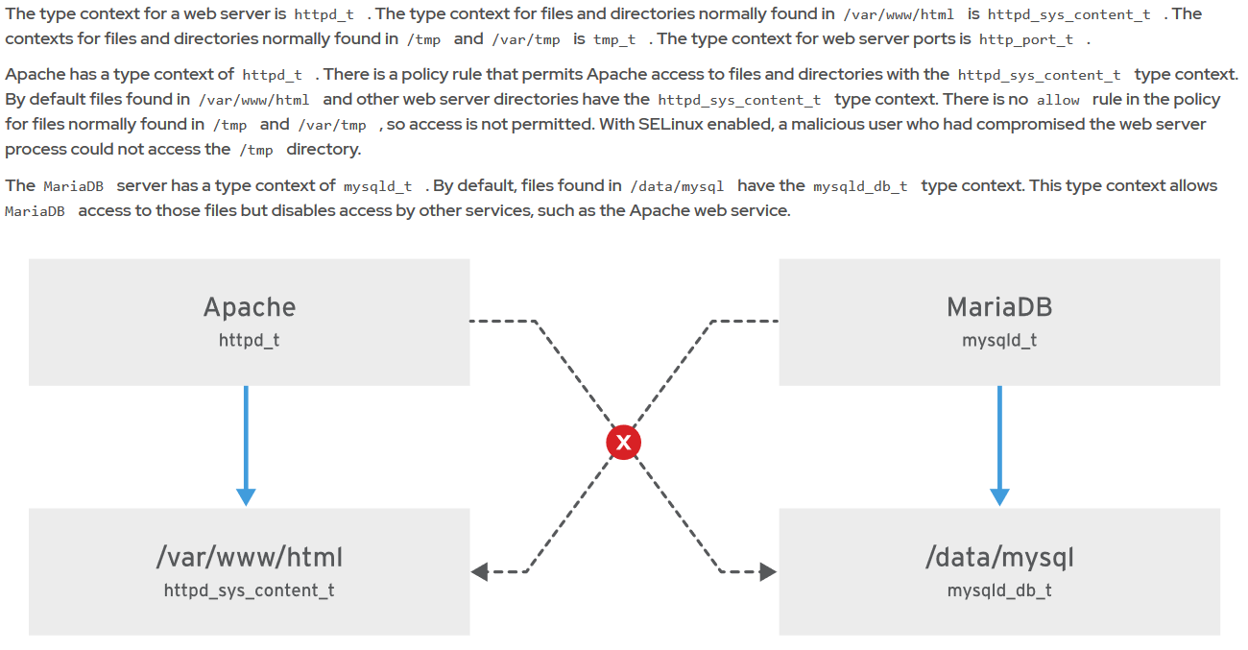

Slide 182
Red Hat System Administration II – SA2
Managing SELinux Security
SELinux Modes
SELinux can operate in any of the 3 modes :
Enforced : Actions contrary to the policy are blocked and a corresponding event is logged in the audit log.
Permissive : Actions contrary to the policy are only logged in the audit log.
Disabled : The SELinux is disabled entirely.

Slide 183
Red Hat System Administration II – SA2
Managing SELinux Security
Toggling the SELinux modes temporarily
To switch between the SELinux modes temporarily we can use the setenforce command as shown below :
setenforce [ Enforcing | Permissive | 1 | 0 ]
0 –> Permissive 1 –> Enforcing

Slide 184
Red Hat System Administration II – SA2
Managing SELinux Security
Toggling the SELinux modes temporarily
Or you can simply echo the values into the pseudo file – /sys/fs/selinux/enforce or /selinux/enforce.
echo [0|1] > /sys/fs/selinux/enforce
To check the current mode of SELinux :
getenforce
Enforcing

Slide 185
Red Hat System Administration II – SA2
Managing SELinux Security
Changing SELinux modes Permanently
One way of changing the SELinux mode permanently to either of Enforcing or Permissive is – to edit the /etc/sysconfig/selinux file and set SELINUX parameters value to either enforcing or permissive.
ls -l /etc/sysconfig/selinux
lrwxrwxrwx. 1 root root 17 Mar 2 13:03 /etc/sysconfig/selinux -> ../selinux/config

Slide 186
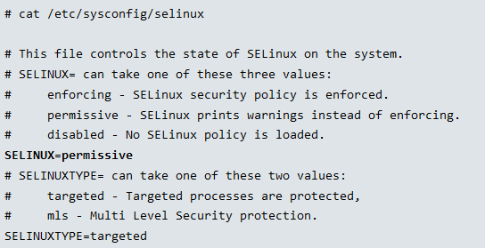
Red Hat System Administration II – SA2
Managing SELinux Security
Changing SELinux modes Permanently

Slide 187
Red Hat System Administration II – SA2
Managing SELinux Security
SELinux Booleans
SELinux Booleans are just like a switch which can be on or off as per requirement. It can be used to change the behaviour of the SELinux policy. SELinux Booleans are rules that can be enabled or disabled. They can be used by security administrators to tune the policy to make selective adjustments.
How to list SELinux Booleans
To view all available Booleans in system we can use getsebool -a command.

Slide 188
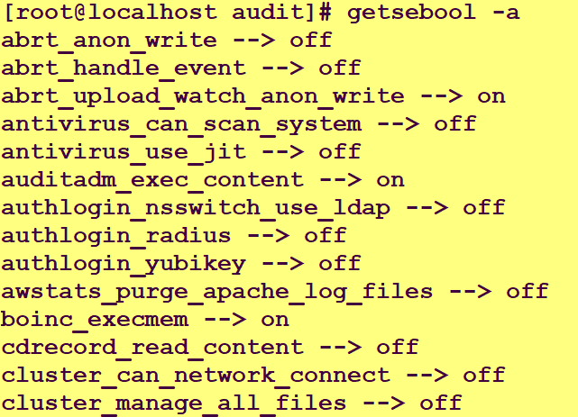
Red Hat System Administration II – SA2
Managing SELinux Security
SELinux Booleans

Slide 189
Red Hat System Administration II – SA2
Managing SELinux Security
SELinux Booleans
To view the status of a single Boolean we have to specify its name with getsebool command.
getsebool ftp_home_dir
ftp_home_dir -->off

Slide 190
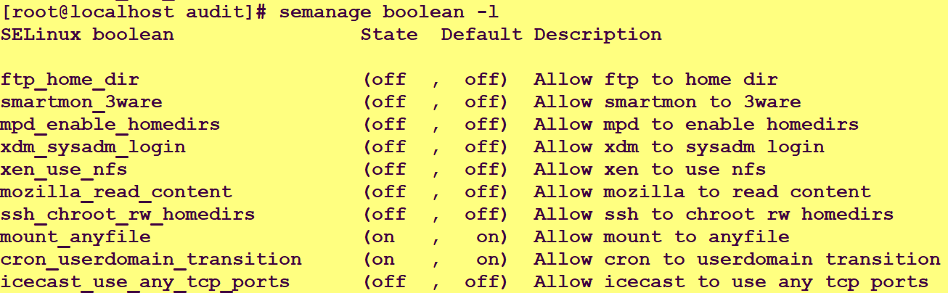
Red Hat System Administration II – SA2
Managing SELinux Security
SELinux Booleans
To get more detailed information about available Booleans such as their current status, default status and description we can use following command
semanage boolean –l

Slide 191
Red Hat System Administration II – SA2
Managing SELinux Security
How to change SELinux Booleans
SELinux Booleans are SELinux policy setting. A SELinux Boolean can be either on or off. If Boolean is on, SELinux will permit the associate action. If Boolean is off, SELinux will deny the associate action.
To change the Boolean setting we can use setsebool command. To enable a Boolean, we can use “on” or “1” option with this command. For example, to enable ftp_home_dir Boolean we can use any one of following commands
setsebool ftp_home_dir on
setsebool ftp_home_dir 1

Slide 192
Red Hat System Administration II – SA2
Managing SELinux Security
How to change SELinux Booleans Permanently
Above commands update Boolean setting in run time. Change made with above commands will not preserve after the reboot. To make a change permanent we have to use -P option. For example, following command will activate ftp_home_dir Boolean permanently.
setsebool -P ftp_home_dir on

Slide 193
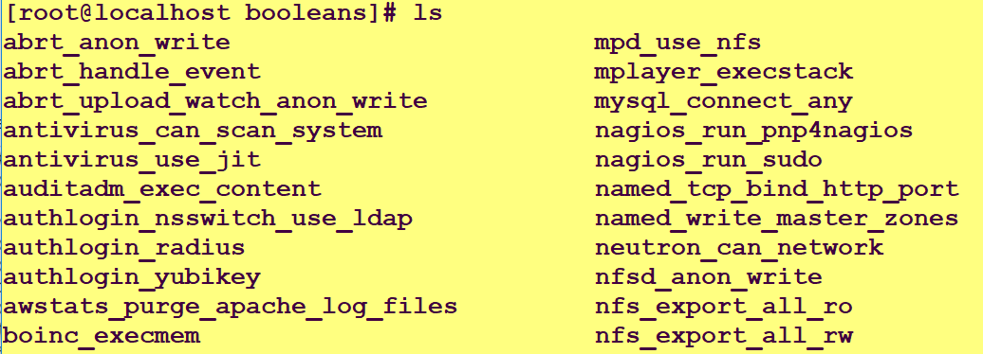
Red Hat System Administration II – SA2
Managing SELinux Security
SELinux boolean directory
SELinux Booleans settings are stored in /sys/fs/selinux/booleans directory.

Slide 194
Red Hat System Administration II – SA2
Managing SELinux Security
Lab Session
Apache can publish web content hosted in user’s home directories, but SELinux prevents this by default. In this exercise, we will identify and change the SELinux Boolean that permits Apache to access user home directories.

Slide 195
Red Hat System Administration II – SA2
Adding Partitions, File Systems, and Persistent mounts
Agenda
Create storage partitions, format them with file systems, and mount them for use.
Create and manage swap spaces to supplement physical memory.

Slide 196
Red Hat System Administration II – SA2
Adding Partitions, File Systems, and Persistent mounts
Partitioning a Disk
Disk partitioning allows system administrators to divide a hard drive into multiple logical storage units, referred to as partitions. By separating a disk into partitions, system administrators can use different partitions to perform different functions.
Benefits of disk partitioning
1. Limit available space to applications or users.
2. Separate operating system and program files from user files.
3. Create a separate area for memory swapping.

Slide 197
Red Hat System Administration II – SA2
Adding Partitions, File Systems, and Persistent mounts
MBR Partitioning Scheme
Since 1982, the Master Boot Record (MBR) partitioning scheme has dictated how disks are partitioned on systems running BIOS firmware.
It supports maximum 4 primary partitions. You can create 4 Primary partitions or 3 primary and 1 extended partitions and with the use of extended and logical partitions, administrators can create a maximum of 15 partitions.

Slide 198
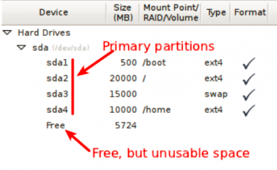
Red Hat System Administration II – SA2
Adding Partitions, File Systems, and Persistent mounts
MBR Partitioning Scheme
It does not allow the configuration of more than four main partitions. Those partitions are called primary partitions.
Disk partitions are limited to 2TB.

Slide 199
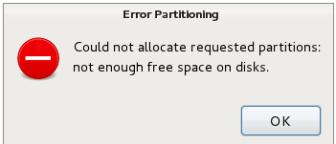
Red Hat System Administration II – SA2
Adding Partitions, File Systems, and Persistent mounts
MBR Partitioning Scheme
As we can see in the figure that we have created 4 primary partitions as sda1,2,3,4 and if we further attempt to create another partition using the free space, then installer will throw an error message i.e. Could not allocate requested partitions, not enough free space on disks.
As shown below

Slide 200
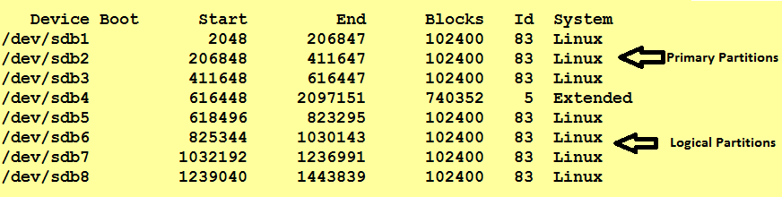
Red Hat System Administration II – SA2
Adding Partitions, File Systems, and Persistent mounts
MBR Partitioning Scheme
So to overcome with partition limitation of MBR, they have came up with the concept of an extended partitions. By extended partitions, we can further create partitions as logical partitions.

Slide 201
Red Hat System Administration II – SA2
Adding Partitions, File Systems, and Persistent mounts
GPT Partitioning Scheme
Physical disks are getting larger, and SAN-based volumes even larger than that, the 2 TiB disk and partition size limit of the MBR partitioning scheme is no longer a theoretical limit, but rather a real-world problem that system administrators encounter more and more frequently in production environments. As a result, the legacy MBR scheme is in the process of being superseded by the new GUID Partition Table (GPT) for disk partitioning.
Newer computers come with a replacement firmware for the old BIOS system called UEFI (Unified Extensible Firmware interface), and GPT is a part of the UEFI standard.

Slide 202
Red Hat System Administration II – SA2
Adding Partitions, File Systems, and Persistent mounts
GPT Partitioning Scheme
For systems running Unified Extensible Firmware Interface (UEFI) firmware, GPT is the standard for laying out partition tables on physical hard disks. GPT is part of the UEFI standard and addresses many of the limitations that the old MBR-based scheme imposes.
A GPT provides a maximum of 128 partitions.
Unlike an MBR, which uses 32 bits for storing logical block addresses and size information, a GPT allocates 64 bits for logical block addresses.

Slide 203
Red Hat System Administration II – SA2
Adding Partitions, File Systems, and Persistent mounts
GPT Partitioning Scheme
This allows a GPT to accommodate partitions and disks of up to eight zebibytes (ZiB) or eight billion tebibytes.
In addition to addressing the limitations of the MBR partitioning scheme, a GPT also offers some additional features and benefits. A GPT uses a globally unique identifier (GUID) to identify each disk and partition. In contrast to an MBR, which has a single point of failure, a GPT offers redundancy of its partition table information. The primary GPT resides at the head of the disk, while a backup copy, the secondary GPT, is housed at the end of the disk. A GPT uses a checksum to detect errors and corruptions in the GPT header and partition table.

Slide 204
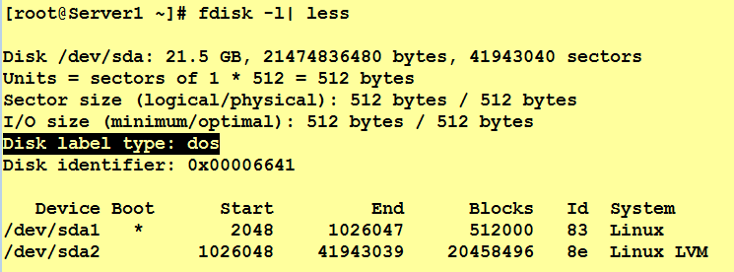
Red Hat System Administration II – SA2
Adding Partitions, File Systems, and Persistent mounts
How to identify what partitioning standard is used

Slide 205
Red Hat System Administration II – SA2
Adding Partitions, File Systems, and Persistent mounts
Lab Session

Slide 206
Red Hat System Administration II – SA2
Adding Partitions, File Systems, and Persistent mounts
Introducing Swap Space Concepts
A swap space is an area of a disk under the control of the Linux kernel memory management subsystem. The kernel uses swap space to supplement the system RAM by holding inactive pages of memory. The combined system RAM plus swap space is called virtual memory .
When the memory usage on a system exceeds a defined limit, the kernel searches through RAM looking for idle memory pages assigned to processes. The kernel writes the idle pages to the swap area and reassigns the RAM pages to other processes. If a program requires access to a page on disk, the kernel locates another idle page of memory, writes it to disk, then recalls the needed page from the swap area.

Slide 207
Red Hat System Administration II – SA2
Adding Partitions, File Systems, and Persistent mounts
Setting the Swap Space Priority
By default, the system uses swap spaces in series, meaning that the kernel uses the first activated swap space until it is full, then it starts using the second swap space. However, you can define a priority for each swap space to force that order.
To set the priority, use the pri option in /etc/fstab . The kernel uses the swap space with the highest priority first. The default priority is -2.
The following example shows three swap spaces defined in /etc/fstab . The kernel uses the last entry first, with pri=10 . When that space is full, it uses the second entry, with pri=4 . Finally, it uses the first entry, which has a default priority of -2.

Slide 208
Red Hat System Administration II – SA2
Adding Partitions, File Systems, and Persistent mounts
Setting the Swap Space Priority

Slide 209
Red Hat System Administration II – SA2
Creating Logical Volumes
Agenda
Create and manage logical volumes from storage devices, and format them with file systems or prepare them with swap spaces.
Add and remove storage assigned to volume groups, and nondestructively extend the size of a logical volume formatted with a file system.

Slide 210
Red Hat System Administration II – SA2
Extending and Reducing a Volume Group
Extending a Logical Volume and XFS File System
Extend a Logical Volume and swap space
Creating Logical Volumes
LAB SESSION

Slide 211
Red Hat System Administration II – SA2
Mounting Network-Attached Storage with NFS
Agenda
Mount and unmount an NFS export from the command line and at boot time.
Configure the automounter with direct and indirect maps to automatically mount an NFS file system on demand, and unmount it when it is no longer in use.
Configure an NFS client to use NFSv4 using the new nfsconf tool.

Slide 212
Red Hat System Administration II – SA2
Mounting Network-Attached Storage with NFS
Network File System is a NFS Server-Client protocol used for sharing files and directories between Linux / Unix to Unix/Linux systems and vise versa. It is a popular distributed filesystem protocol that enables users to mount remote directories on their server. NFS enables you to mount a remote share locally. NFS was developed by Sun Micro Systems in the year 1984
NFS allows a Linux server to share directories with other UNIX clients over network. NFS server exports a directory and NFS client mounts this directory.
The default NFS version in Red Hat Enterprise Linux 8 is 4.2. NFSv4 and NFSv3 major versions are supported. NFSv2 is no longer supported. NFSv4 uses only the TCP protocol to communicate with the server; earlier NFS versions could use either TCP or UDP.

Slide 213
Red Hat System Administration II – SA2
Mounting Network-Attached Storage with NFS
NFS default port number is 2049
NFS servers export shares (directories). NFS clients mount an exported share to a local mount point (directory), which must exist. NFS shares can be mounted a number of ways:
Manually, using the mount command.
Automatically at boot time using /etc/fstab entries.
On demand, using either the autofs service or the systemd.automount facility.

Slide 214
Red Hat System Administration II – SA2
Mounting Network-Attached Storage with NFS
The nfsconf Tool
Red Hat Enterprise Linux 8 introduces the nfsconf tool to manage the NFS client and server configuration files under NFSv4 and NFSv3. Configure the nfsconf tool using /etc/nfs.conf (the /etc/sysconfig/nfs file from earlier versions of the operating system is deprecated now). Use the nfsconf tool to get, set, or unset NFS configuration parameters.
Use the nfsconf --set section key value to set a value for the key in the specified section.

Slide 215
Red Hat System Administration II – SA2
Mounting Network-Attached Storage with NFS
The nfsconf Tool
nfsconf --set nfsd vers4.2 y
Use the nfsconf --get section key to retrieve the value for the key in the specified section:
nfsconf --get nfsd vers4.2
y
Use the nfsconf --unset section key to unset the value for the key in the specified section:
nfsconf --unset nfsd vers4.2

Slide 216
Red Hat System Administration II – SA2
Mounting Network-Attached Storage with NFS
Lab Session
NFS Server - server1.example.com (192.168.209.128)
NFS Client - client.example.com (192.168.209.134)

Slide 217
Red Hat System Administration II – SA2
Mounting Network-Attached Storage with NFS
Lab Session
Shares the /nshare4 directory which contains some text files and members of admin group (nfsuser) have read and write access to the /nshare4.
The priniciple mount point for client is /nshare4.
Configure NFS Clients to user NFSv4, tcp and disable nfsd vers2, 3 and udp.
NFS Server - server1.example.com (192.168.209.128)
NFS Client - client.example.com (192.168.209.134)

Slide 218
Red Hat System Administration II – SA2
Automounting Network-Attached Storage
Mounting NFS Shares with the Automounter
The automounter is a service ( autofs ) that automatically mounts NFS shares "on-demand," and will automatically unmount NFS shares when they are no longer being used.

Slide 219
Red Hat System Administration II – SA2
Automounting Network-Attached Storage
Automounter Benefits
Users do not need to have root privileges to run the mount and umount commands.
NFS shares configured in the automounter are available to all users on the machine, subject to access permissions.
NFS shares are not permanently connected like entries in /etc/fstab , freeing network and system resources.
The automounter is configured on the client side; no server-side configuration is required.
The automounter uses the same options as the mount command, including security options.
The automounter supports both direct and indirect mount-point mapping, for flexibility in mount-point locations.
autofs creates and removes indirect mount points, eliminating manual management.

Slide 220
Red Hat System Administration II – SA2
Mounting Network-Attached Storage with NFS
Lab Session
From NFS Server, exports the directory /important/docs as an NFS Share and on client machine, it should be automounted using a indirect map on /linux/docs
NFS Server - server1.example.com (192.168.209.128)
NFS Client - client.example.com (192.168.209.134)

Slide 221
Red Hat System Administration II – SA2
Mounting Network-Attached Storage with NFS
Lab Session on Indirect Wildcard Maps
From NFS Server, exporting as an NFS share the /database/docs directory, which in turn contains the west, central and east subdirectories.
On client machine, /database/docs/west should be automounted using a indirect map on /promo/west.
/database/docs/east ➔ /promo/east
/database/docs/central ➔ /promo/central
NFS Server - server1.example.com (192.168.209.128)
NFS Client - client.example.com (192.168.209.134)

Slide 222
Red Hat System Administration II – SA2
Mounting Network-Attached Storage with NFS
Lab Session on Direct maps
From NFS Server, exports the directory /direct/docs as an NFS Share and on client machine, it should be automounted using a direct map on /direct/docs
NFS Server - server1.example.com (192.168.209.128)
NFS Client - client.example.com (192.168.209.134)

Slide 223
Red Hat System Administration II – SA2
Controlling the Boot Process
Agenda
Describe the Red Hat Enterprise Linux boot process, set the default target used when booting, and boot a system to a non-default target.
Log in to a system and change the root password when the current root password has been lost.
Manually repair file system configuration or corruption issues that stop the boot process.

Slide 224
Controlling the Boot Process
BIOS – Basic Input Output System
Power-On-Self-Test is executed, It keeps the information about bootable device
MBR – The Master Boot Record is the information in the first sector of any hard disk. Simply MBR Loads Grub2 bootloader
GRUB2 (Grand Unified Bootloader) Version 2.
GRUB2 loads its configuration from the/boot/grub2/grub.cfg file and displays a menu where you can select which kernel to boot.
It loads the vmlinuz kernel Image (/boot/vmlinuz-4.18.0-80.el8.x86_64) and extract the content of Initramfs image (initramfs-4.18.0-80.el8.x86_64.img)
Kernel
It loads necessary driver modules from initramfs.
It starts the system’s first process, systemd
Systemd process is the first process ID (PID 1) to run on RHEL7/8 systems.
it initializes the system and launches all the services that were once started by the traditional init process. Systemd process reads the configuration file of /etc/systemd/system/default.target, then its load the OS in targeted runlevel.target.

Slide 225

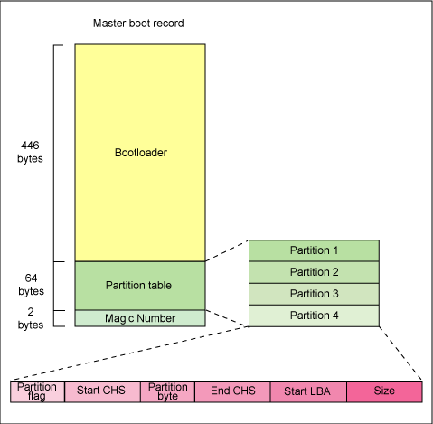
Controlling the Boot Process
BIOS
HDD (/dev/sda)
MBR
Grub2
GRUB2 (Grand Unified Bootloader) Version 2.
GRUB2 loads its configuration from the/boot/grub2/grub.cfg file and
displays a menu where you can select which kernel to boot.
It loads the vmlinuz kernel Image (/boot/vmlinuz-4.18.0-80.el8.x86_64) and
extract the content of Initramfs image (initramfs-4.18.0-80.el8.x86_64.img)
POST – Power On Self Test
Search for Bootable Device
HDD, CD/DVD, USB, LAN, HBA Card
Kernel , initramfs
Kernel Initializes all hardware
Executes /sbin/init
Systemd executes initrd.target
Kernel Initializes all hardware for which
it can find a driver in the initramfs
Then kernel executes /sbin/init from the initramfs as PID1.
On RHEL 8, /sbin/init is a link to systemd
The Systemd instance from the
Initramfs executes all units for the
Initrd.target target. This includes
Mounting the root file system on disk on
to the /sysroot directory.
Mounting root fs on /sysroot directory
Root fs switched
Systemd looks for default.target
starts/stops units
systemd reads the file linked by /etc/systemd/system/default.target
(for example, /usr/lib/systemd/system/multi-user.target) to determine the default system target (equivalent to run level).
The system target file defines the services that systemd starts.
Kernel root FS switched from initramfs root (/sysroot) to system rootfs (/) and
systemd re-executes as system version
Systemd looks for default target and starts/stops units as configured
while automatically solving dependencies and login page appears.

Slide 226
Red Hat System Administration II – SA2
Controlling the Boot Process
Rebooting and Shutting Down

Slide 227
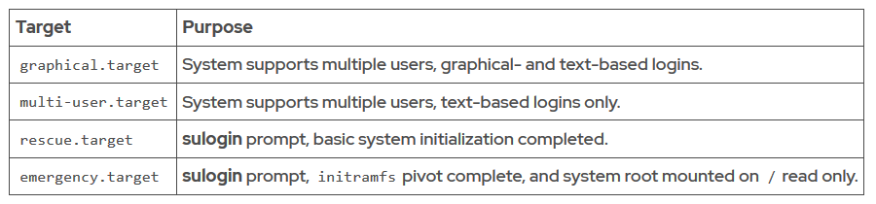
Red Hat System Administration II – SA2
Controlling the Boot Process
Selecting a Systemd Target

Slide 228
Red Hat System Administration II – SA2
Controlling the Boot Process
Exercise
Determine the default target and change the target into running system.
Selecting a rescue target at boot time.

Slide 229
Red Hat System Administration II – SA2
Controlling the Boot Process
Resetting the Root Password

Slide 230
Red Hat System Administration II – SA2
Controlling the Boot Process
Repairing Systemd Boot Issues
To troubleshoot service startup issues at boot time, Red Hat Enterprise Linux 8 makes the following tools available.
Boot the RHEL 8 into Rescue mode
Boot the RHEL 8 into Emergency mode
Enabling the Early Debug Shell

Slide 231
Red Hat System Administration II – SA2
Controlling the Boot Process
Booting RHEL 8 into Rescue Mode
Rescue mode is equivalent to single user mode and requires the root password.
Rescue mode allows you to repair your system in situations when it is unable to complete a regular booting process.
Rescue mode will try to mount all local file systems and start some important system services, but it does not activate network interfaces neither allow multiple users to be logged in.

Slide 232
Red Hat System Administration II – SA2
Controlling the Boot Process
Booting RHEL 8 into Rescue Mode
There are 2 ways to get into rescue mode :
Method 1 There is a GRUB2 menu option when you boot up the system which can be selected to directly boot into rescue mode.

Slide 233
Red Hat System Administration II – SA2
Controlling the Boot Process
Booting RHEL 8 into Rescue Mode
Method 2
During bootup, when the GRUB2 menu shows up, press the e key for edit.
Add the following parameter at the end of the linux line: systemd.unit=rescue.target
Press Ctrl+a (or Home) and Ctrl+e (or End) to jump to the start and end of the line.
Press Ctrl+x to boot the system with the parameter.

Slide 234
Red Hat System Administration II – SA2
Controlling the Boot Process
Booting RHEL 8 into Emergency Mode
Emergency mode provides the most minimal environment possible and allows you to repair your system even in situations when the system is unable to enter rescue mode.
In emergency mode, the system mounts the root file system as read-only, does not attempt to mount any other local file systems, does not activate network interfaces. and only starts few essential services.
In Red Hat Enterprise Linux 8, emergency mode requires the root password.

Slide 235
Red Hat System Administration II – SA2
Controlling the Boot Process
Booting RHEL 8 into Emergency Mode
Method to boot into Emergency Mode:
During bootup, when the GRUB2 menu shows up, press the e key for edit.
Add the following parameter at the end of the linux line: systemd.unit=emergency.target
Press Ctrl+a (or Home) and Ctrl+e (or End) to jump to the start and end of the line.
Press Ctrl+x to boot the system with the parameter.

Slide 236
Red Hat System Administration II – SA2
Controlling the Boot Process
Enabling the Early Debug Shell
By enabling the debug-shell service with systemctl enable debug-shell.service , the system spawns a root shell onTTY9( Ctrl + Alt + F9 ) early during the boot sequence. This shell is automatically logged in as root, so that administrators can debug the system while the operating system is still booting.

Slide 237
Red Hat System Administration II – SA2
Controlling the Boot Process
Repairing File System Issues at Boot
Corrupt file system : systemd attempts to repair the file system. If the problem is too severe for an automatic fix, the system drops the user to an emergency shell.
Nonexistent device or UUID in /etc/fstab
Nonexistent mount point in /etc/fstab
Incorrect mount options specified in /etc/fstab
Note: You can use nofail option in the /etc/fstab file permits the system to boot even if the mount of that file system is not successful.

Slide 238
Red Hat System Administration II – SA2
Controlling the Boot Process
Repairing File System Issues at Boot
Lab Session

Slide 239
Red Hat System Administration II – SA2
Manage Network Security
Managing Server Firewalls
The Linux kernel includes netfilter, a framework for network traffic operations such as packet filtering, network address translation and port translation.
Netfilter is the primary component in Red Hat Enterprise Linux 8 firewalls.
A Packet filtering firewall reads incoming network packets and filters (allows or denies) each data packet based on the header information in the packet. The Linux kernel has built-in packet filtering functionality called Netfilter.

Slide 240
Red Hat System Administration II – SA2
Manage Network Security
Managing Server Firewalls
Nftables enhances netfilter
The Linux kernel also includes nftables, a new filter and packet classification subsystem that has enhanced portions of netfilter's code.
The advantages of the nftables update is faster packet processing, faster ruleset updates, and simultaneous IPv4 and IPv6 processing from the same rules.
Another major difference between nftables and the original netfilter are their interfaces. Netfilter is configured through multiple utility frameworks, including iptables, ip6tables, arptables, and ebtables, which are now deprecated. Nftables uses the single nft user-space utility, allowing all protocol management to occur through a single interface.

Slide 241
Red Hat System Administration II – SA2
Manage Network Security
Managing Server Firewalls
Firewalld is a dynamic firewall manager, a front end to the nftables framework using the nft command. Until the introduction of nftables, firewalld used the iptables command to configure netfilter directly, as an improved alternative to the iptables service.
In RHEL 8,firewalld remains the recommended front end, managing firewall rulesets using nft .

Slide 242
Red Hat System Administration II – SA2
Manage Network Security
Managing Server Firewalls
The default firewall service in RHEL 7,8 is firewalld.
It is a dynamic firewall manager which supports firewall (network) zones.
The firewalld service has support for IPv4, IPv6, and for Ethernet bridges.

Slide 243
Red Hat System Administration II – SA2
Manage Network Security
Managing Server Firewalls
Advantages over iptables
Firewalld has the following advantages over iptables :
Unlike the iptables command, the firewall-cmd command does not restart the firewall and disrupt established TCP connections.
firewalld supports dynamic zones.
firewalld supports D-Bus for better integration with services that depend on firewall configuration.

Slide 244
Red Hat System Administration II – SA2
Manage Network Security
Managing Server Firewalls
Configuration options
The firewalld service has two types of configuration options:
Runtime: Changes to firewall settings take effect immediately but are not permanent. Changes made in runtime configuration mode are lost when the firewalld service is restarted.
Permanent: Changes to firewall settings are written to configuration files. These changes are applied when the firewalld service restarts.

Slide 245
Red Hat System Administration II – SA2
Manage Network Security
Managing Server Firewalls
Configuration files
Configuration files for firewalld exist in two directories:
/usr/lib/firewalld: Contains default configuration files. Do not make changes to these files. An upgrade of the firewalld package overwrites this directory.
/etc/firewalld: holds system configuration files. These files will overwrite a default configuration.

Slide 246
Red Hat System Administration II – SA2
Managing Network Security
Managing Server Firewalls
Firewalld Components
Drop Zone: Any incoming packets are dropped, if we use this drop zone. This is same as we use to add iptables -j drop. If we use the drop rule, means there is no reply, only outgoing network connections will be available.
Block Zone: Block zone will deny the incoming network connections are rejected with an icmp-host-prohibited. Only established connections within the server will be allowed.
Public Zone: To accept the selected connections we can define rules in public zone. This will only allow the specific port to open in our server other connections will be dropped.

Slide 247
Red Hat System Administration II – SA2
Managing Network Security
Managing Server Firewalls
Firewalld Components
External Zone: This zone will act as router options with masquerading is enabled other connections will be dropped and will not accept, only specified connection will be allowed.
DMZ Zone: If we need to allow access to some of the services to public, you can define in DMZ zone. This too have the feature of only selected incoming connections are accepted.
Work Zone: In this zone, we can define only internal networks i.e. private networks traffic are allowed.

Slide 248
Red Hat System Administration II – SA2
Managing Network Security
Managing Server Firewalls
Firewalld Components
Home Zone: This zone is specially used in home areas, we can use this zone to trust the other computers on networks to not harm your computer as every zone. This too allow only the selected incoming connections.
Internal Zone: This one is similar to work zone with selected allowed connections.
Trusted Zone: If we set the trusted zone all the traffic are accepted.

Slide 249
Red Hat System Administration II – SA2
Managing Network Security
Managing Server Firewalls
For each zone you can define the following features:
Services: Predefined or custom services to trust. Trusted services are a combination of ports and protocols that are accessible from other systems and networks.
Ports: Additional ports or port ranges and associated protocols that are accessible from other systems and networks.
Masquerading: Translate IPv4 addresses to a single external address. With masquerading enabled, addresses of a private network are mapped to and hidden behind a public address.

Slide 250
Red Hat System Administration II – SA2
Managing Network Security
Managing Server Firewalls
Port Forwarding: Forward inbound network traffic from a specific port or port range to an alternative port on the local system, or to a port on another IPv4 address.
ICMP Filter: Block selected Internet Control Message Protocol messages.
Rich Rules: Extend existing firewalld rules to include additional source and destination addresses and logging and auditing actions.
Interfaces: Network interfaces bound to the zone. The zone for an interface is specified with the ZONE=option in the /etc/sysconfig/network-scripts/ifcfg file. If the option is missing, the interface is bound to the default zone.

Slide 251
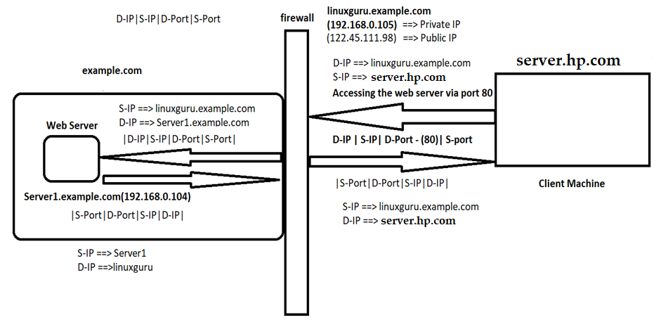
Red Hat System Administration II – SA2
Managing Network Security

Slide 252
Red Hat System Administration II – SA2
Automating Installation with Kickstart
Kickstart
A system administrator can automate the installation of Linux Operating System using a feature called kickstart. Kickstart is an automated installation method used primarily by Red Hat Enterprise Linux (and other Fedora spin-offs, such as CentOS, Oracle Linux, etc.) to execute unattended operating system installation and configuration. Anaconda, the Red Hat Installer, needs to be told how to install a systems; partition disks, configure network interfaces, select which packages to install, etc. A kickstart installation uses a text file to provide all of the answers to these questions, so no interaction is required. We have to create a kickstart config file which contains all answers for operating system installation.
We can use Kickstart method to install N number of servers yet the same time because this method does not required user intervention while installation process
Kickstart in RHEL is similar to Jumpstart in Solaris, Ignite in HP-Unix.

Slide 253
Red Hat System Administration II – SA2
Automating Installation with Kickstart
Kickstart
Automated OS Installation Advantages
We can install multiple servers in one go or simultaneously.
Minimize manual intervention and save time.
Multiple Distributions also supported.
Post installation scripts helps in automating more tasks.

Slide 254
Red Hat System Administration II – SA2
Automating Installation with Kickstart
Kickstart
Kickstart Method uses below protocols for the installation of OS automatically
NFS
HTTP
FTP

Slide 255
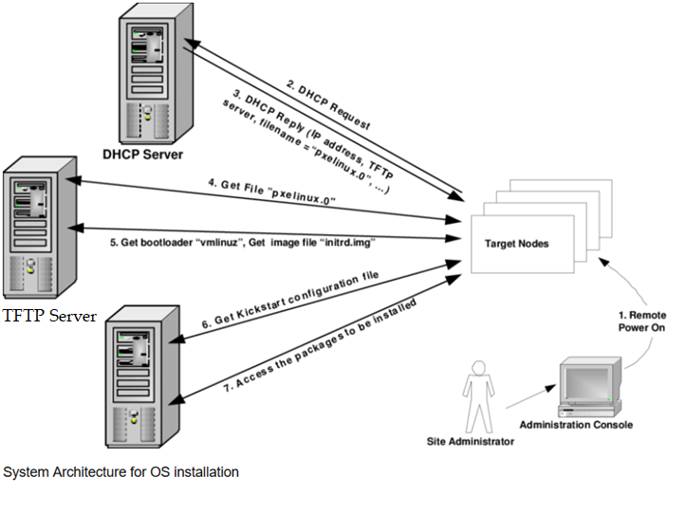

Slide 256


Red Hat System Administration II – SA2
Automating Installation with Kickstart

Slide 257
Where to download RHEL, CentOS, VMware Workstation & Oracle VirtualBox
RHEL Iso Image
https://access.redhat.com/downloads
CentOS Iso Image
http://isoredirect.centos.org/centos/ or https://www.centos.org/download/
VMware Workstation
https://www.vmware.com/in/products/workstation-pro.html
Oracle VM VirtualBox
https://www.virtualbox.org/wiki/Downloads

Slide 258
Where to download RHEL8, CentOS8, VMware Workstation & Oracle VirtualBox
How to Download RHEL8 ISO File Free (Download for Development Use)
https://sso.redhat.com/
https://developers.redhat.com/rhel8/

Slide 259
Download RHEL8, CentOS8, VMware Workstation & Oracle VirtualBox
How to Download RHEL8 ISO File Free (Download for Development Use)
https://sso.redhat.com/
https://developers.redhat.com/rhel8/

Slide 260
Linux Administration
Introduction of Unix
UNIX is an operating system which was first developed in the 1960s, and has been under constant development ever since. By operating system, we mean the suite of programs which make the computer work.
Unix is a multi-user, multi-tasking operating system. You can have many users logged into a system simultaneously, each running many programs.

Slide 261
Linux Administration
Unix Architecture
Application Programs
Mail Server
Shell
Kernel
Hardware
DBMS
FTP

Slide 262
Linux Administration
History of Unix
First Version was created in Bell Labs in 1969.
Some of the Bell Labs programmers who had worked on this project, Ken Thompson, Dennis Ritchie, Rudd Canaday, and Doug McIlroy designed and implemented the first version of the Unix File System on a PDP-7 along with a few utilities. It was given the name UNIX by Brian Kernighan.
1973 Unix is re-written mostly in C, a new language developed by Dennis Ritchie.

Slide 263
Linux Administration
History of Unix
1977 There were about 500 Unix sites world-wide.
1980 BSD 4.1 (Berkeley Software Development)
1983 SunOS, BSD 4.2, System V
1988 AT&T and Sun Microsystems jointly develop System V Release 4 (SVR4). This later developed into UnixWare and Solaris 2.
1991 Linux was originated.

Slide 264

Linux Administration
History of Linux
In June 1971, Richard Mattew Stallman joined MIT Artificial Intelligence Laboratory as a programmer where gained popularity with the hacker community and came to know by his now popular name RMS.
At that time, all the programmers used to share their code freely among each other cutting across various institutions.

Slide 265
Linux Administration
History of Linux
In 1980, with the advent of portable software i.e. software that can be compiled to run on different computers, a business model emerged.
So the companies developing the code refused to share the code with their clients and began restricting copying and redistribution of their software by copyrighting it.
In response to this trend, Stallman, who believed in the principle that software has to be free always, founded the Free Software Foundation and in 1985, published the GNU Manifesto.

Slide 266
Linux Administration
History of Linux
This manifesto outlined his motivation for creating a free OS called GNU, which would be compatible with Unix.
He along with a group of like minded programmers started work in developing the tools needed to make a complete OS.
In 1983, Richard Stallman started the GNU project with the goal of creating a free UNIX-like operating system. As part of this work, he wrote the GNU General Public License.
In 1989, Stallman released the first program independent GNU General Public Licence now popularly known as GPL or copyleft.

Slide 267

Linux Administration
History of Linux
In the same same year (1985), a professor by name Andy Tanenbaun wrote a Unix like Operating system from scratch for the Intel i386 platform. He named it MInix.

Slide 268
Linux Administration
History of Linux
In 1990, A finnish student by name Linus Torvalds studying in the University of Helsinki came into contact with Andy Tanenbaum's OS, Minix.
Linus wanted to upgrade Minix by putting in more features and improvements but he was prohibited by Tanenbaun to do so.
Linus then decided to write his own kernel and released it under GPL.
This Kernel is now popularly known as Linux

Slide 269
Red Hat System Administration II – SA2
Automating Installation with Kickstart

